Slide 1

AZURE PRIMER
Arturo Quiroga (CSA-P)
Microsoft Canada

Slide 2
Introduction to Azure IAAS
Overview of IAAS
Notes:
45 minute session

Slide 3
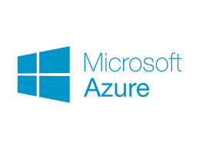
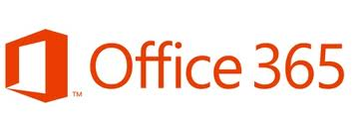



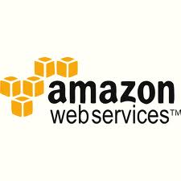




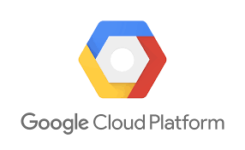
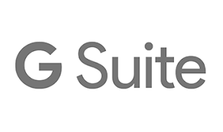

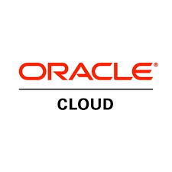

What is “the cloud” ?
Characteristics
On demand Self Service
Multi-Tenancy (Resource Pooling)
Pay as you go
Rapid Elasticity
Metered Real-time Billing
Charge Back
Deployment Models
Public
Private
Hybrid
Hosted
IaaS Providers | PaaS Providers | SaaS Providers
Notes:
Focus on vendors providing services in each tier

Slide 4
Cloud Service Models
Traditional
On Premises
Infrastructure
(as a Service)
Platform
(as a Service)
Software
(as a Service)
Applications
Applications
You manage
Applications
Applications
Data
You manage
Data
Data
Data
Runtime
Runtime
Runtime
Runtime
Managed by vendor
You manage
Middleware
Middleware
Middleware
Middleware
O/S
O/S
O/S
Managed by vendor
O/S
Virtualization
Virtualization
Managed by vendor
Virtualization
Virtualization
Servers
Servers
Servers
Servers
Storage
Storage
Storage
Storage
Networking
Networking
Networking
Networking
Notes:
.

Slide 5
Introduction to Azure IaaS
IaaS Use Cases

Slide 6
Common Reasons for IaaS
Lift n’ Shift
Rehost
Refactor
Redesign
Rebuild
Replace
Lift and shift
DevOps and Containers
Modernize apps with
PaaS
Cloud native
3rd party
SaaS
Notes:
When initially migrating workloads onto Azure from on-premises, choices need to be made on whether applications will be decommissioned, re-platformed, rebuilt or replaced. This can impact the decision on whether to select IaaS, Paas or SaaS offerings
Quick transition to cloud and allows for portability - Often the choice is made to migrate workloads into Azure ‘as-is’ to avoid any risk and additional effort introduced by refactoring or redesigning business applications. This results in adoption of like for like Compute, Network and Storage IaaS components in Azure. Also provides immediate benefits such as scalability, flexibility, elasticity and management
Some examples where Lift n’ Shift approach to workloads onto IaaS may be preferred
- Legacy or ‘internally optimized’ apps (performs a business function but don’t want to invest time to refactor it to fit into PaaS)
Business-critical\sensitive workloads – Determination that the app is critical and can’t be refactored/transformed without a large project
Time constrained – Workload must be migrated and there is no time to refactor for PaaS

Slide 7
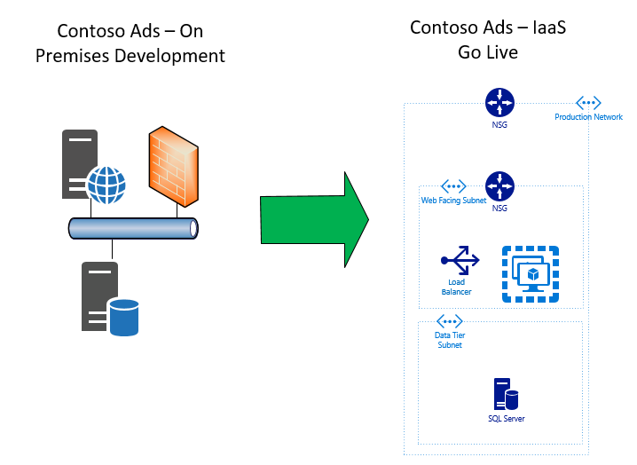
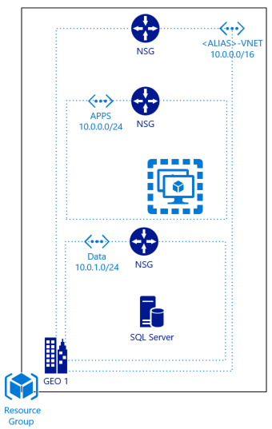
Contoso Ads Scenario
Lift n’ Shift
Notes:
Contoso Ads Scenario – Speed – Get to market without any need for refactoring
Contoso Ads originally designed and tested using on-premises infrastructure.
Contoso wanted to get the application to market and expect application consumption to grow rapidly.
To get to market quickly as well as allow for elasticity, supportability and flexibility, they are able to build IaaS components based on their on-premises environment and feel confident the application will continue to function as expected.
Little to no change to application code required

Slide 8



Other Common Reasons for IaaS
Security, Application or Policy Requirement
Security
Companies\Agencies with very specific security practices and policies
Control
There is a specific reason to interact/modify/control Operating System behavior
Policy
Vendor and technology lock in objections
Notes:
Examples
Security – Companies\Agencies with very specific security practices and policies
In PaaS the service provider’s administrators may have privileged access to the operating system. This means it is easier for them to access app data than if they only had access to disk images.
In providing the management service, additional connections between company machines and the management infrastructure are likely. This infrastructure is an additional attack vector compared to the simple IaaS case.
Control – There is a specific reason to interact/modify/control Operating System behavior - greater control with IaaS than with PaaS or SaaS services as you can manage everything from the Operating System level and up. This can be a requirement for some types of workloads (including bespoke and legacy applications).
Other Policy Considerations - Vendor and technology lock in objections. Businesses feel that IaaS gives more freedom to quickly and easily shift workloads between vendors. Additionally technology architecture lock in, road maps for PaaS not always known.

Slide 9
Introduction to Azure IAAS
Compute and Virtual Machines

Slide 10
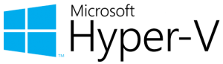

Azure Virtual Machines compatibility with Hyper-V Virtual Machines
Support for Generation 1 Virtual Machines
Storage
Support for VHD fixed format only (no VHDX)
2 TB Maximum Size of OS Disk
4 TB Maximum Size of a Data Disks
Maximum of 64 data disks
256TB of Diskspace
Performance
Up to 128 vCPUs
Notes:
OS Disk max size is 2 TB based on https://docs.microsoft.com/en-us/azure/virtual-machines/windows/about-disks-and-vhds

Slide 11

IAAS VM Compute Tiers (“VM Sizes”)
GENERAL PURPOSE
High CPU-to-memory ratio. Good for medium traffic web servers, network appliances, batch processes, and application servers.
Balanced CPU-to-memory ratio. Ideal for testing and development, small to medium databases, and low to medium traffic web servers.
COMPUTE OPTIMIZED
B (Preview) Dsv3, Dv3, DSv2, Dv2, DS, D, Av2, A0-7
Fs, F
MEMORY OPTIMIZED
STORAGE OPTIMIZED
High memory-to-CPU ratio. Great for relational database servers, medium to large caches, and in-memory analytics.
High disk throughput and IO. Ideal for Big Data, SQL, and NoSQL databases.
Esv3, Ev3, M, GS, G, DSv2, DS, Dv2, D
Ls
Specialized virtual machines targeted for heavy graphic rendering and video editing. Available with single or multiple GPUs.
GRAPHICS OPTIMIZED
HIGH PERFORMANCE COMPUTE
Our fastest and most powerful CPU virtual machines with optional high-throughput network interfaces (RDMA).
NV, NC, NCv2, ND
H, A8-11
New versions tend to indicate new generations of CPU or GPU
https://docs.microsoft.com/en-us/azure/virtual-machines/windows/sizes
Notes:
There are many different ‘Series’ of VM’s in Azure which have unique Compute to RAM rations to suit use cases
Sizes indicate number of processor cores, RAM and data disks can be supported. ‘S’ implies SSD disk for high IO machines
General Purpose – Balanced CPU to memory ratio,
Ideal for testing and dev or small to medium DB’s and low traffic web services
High Performance ( – (remote direct memory access for extremely low latency network comms)
NV instances are powered by NVIDIA’s Tesla M60 GPU card and NVIDIA GRID for desktop accelerated applications and virtual desktops
NC instances are powered by NVIDIA’s Tesla K80 card. Users can now crunch through data much faster by leveraging CUDA for energy exploration applications, crash simulations, ray traced rendering, deep learning and more.

Slide 12
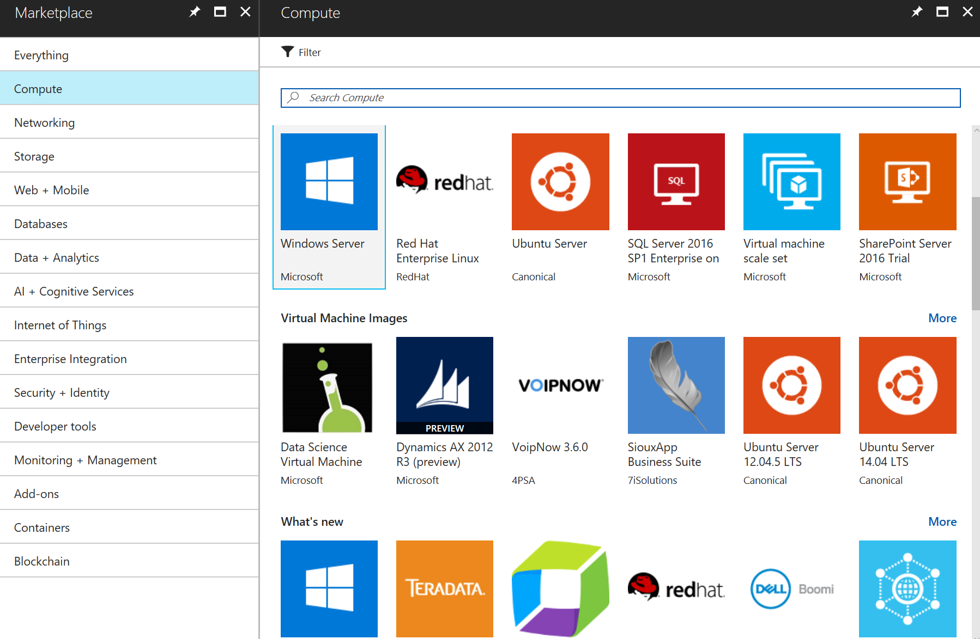
Azure Marketplace – Virtual Machine images
Preconfigured VM Solution images
From both Microsoft and 3rd party vendors
Ready-to-deploy
Licensed through Azure billing, or often supporting Bring Your Own License (BYOL)
Notes:
Animate and highlight Linux and Windows offerings

Slide 13
Introduction to Azure IAAS
IaaS Components

Slide 14
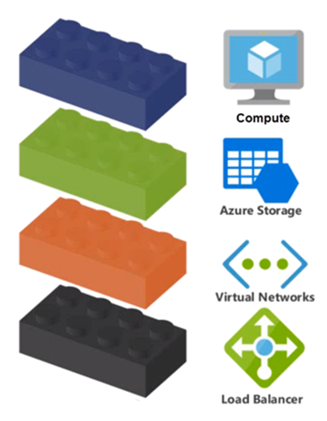
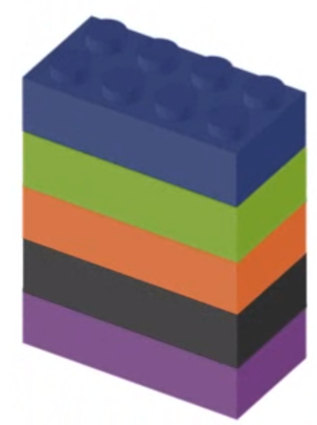
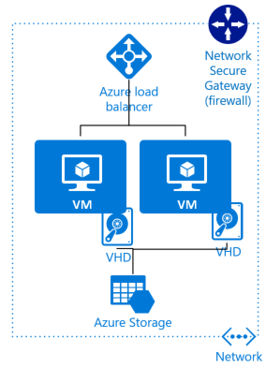
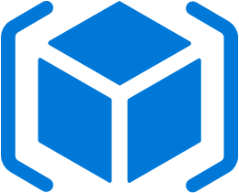
Building Blocks of Azure IaaS
IaaS Components and Resource Groups
Virtual machines, Availability sets, Scale sets…
Storage accounts, disks…
Network interfaces, Virtual networks, Network security groups…
Azure Resource Group
Notes:
IaaS at a high level:
The building blocks of Azure IaaS are made up of Compute resources, Storage resources and Network resources including load balancers
These ‘IT building blocks’ are assembled to meet the needs of a desired system.
Note: There are over 4000 offerings from which to construct the final solution
Assembled components and systems can then be logically grouped together into Azure Resource Groups to help with ongoing management of the resources.
All of these components and concepts are talked about in more depth today and over the course of the week.
We’ll be discussing on the Compute and Storage components in this module and then go into some of the Network components later this morning

Slide 15
Introduction to Azure IAAS
Virtual Machines - Storage

Slide 16


Azure Virtual Machine Disks Storage
Virtual Machine OS and Data Disks exist within in Azure Storage service
Resource or temporary disk exists in hypervisor local storage
Up to 2 TB OS disks
Most Azure Images have System volumes that range from 30GB to 127GB
Up to 4TB Data Disks
Non-OS Volumes larger than 4TB can be created via OS Supported Software RAID
Azure Storage
C: OS Disk (2 TB)
D: Local Temporary Storage
F: Data Disk (500 GB)
G: Data Disk (4 TB)
Beware: Data on the D:\ Drive can/will be lost when a machine is moved or deallocated
Notes:
Every VM will have at least 2 disks (OS and Temp)
C: OS disk is resilient
D: Temp disk is not as it is provisioned from the Hypervisor of the underlying server
Obviously non-critical data should be stored on temp disk
Additional disks are then added based on VM size
You can mix Standard and Premium disks if required

Slide 17

Standard vs Premium Storage
Appropriate for web and application servers that do not have a dependency on high IOPs or low latency storage.
Standard Storage (HDD-based)
Supports up to 500 IOPs per disk
Premium Storage (SSD-based)
Supports up to 7,500 IOPs per disk
Appropriate for data base, file servers, and interactive applications that have a dependency on high IOPs and low latency storage.
Select this link to see premium storage performance targets and limits...
Notes:
This is actually a PaaS service that underlies your Virtual Machine
STANDARD
Disks can be deployed as part of a volume set to increase IOPS if required
Standard supports local and geo-redundant copies of files/disk
PREMIUM
Great for Relational Database Services
Only supports locally redundant resiliency option
NOTE
VM disks support certain durability options
For VM Storage
There are 3 copies of each disk in the local region for durability
Optionally – you can enable geo-redundancy for additional durability (creates another 3 copies in sister region) in an asynchronous fashion (this will ensure survival in a DC outage)

Slide 18
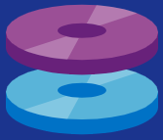
Azure Managed Disks
Optional, but recommended
Storage Account scalability limits do not apply
More granular RBAC support
Grant/deny access to operations, such as read, delete, export and retrieving a Shared Access Signature
Disk Snapshots (full disk copy)
Read-only copy of a disk at a point in time.
Independent of source disk; use to create new managed disks
Supported with Azure Backup
Just manage the disks. Underlying storage accounts managed by the platform

Slide 19
Introduction to Azure IAAS
Virtual Machine Networking

Slide 20
Virtual Machine Networking Overview
IPv4 and IPv6 Support
Support for multiple network interfaces for routing and firewalls
Private and/or Public IP addresses (static or dynamic)
Network Security Groups for traffic isolation
Automatic assignment of DNS servers from virtual network or from Azure DNS
Accelerated Networking
MAC Persistence

Slide 21
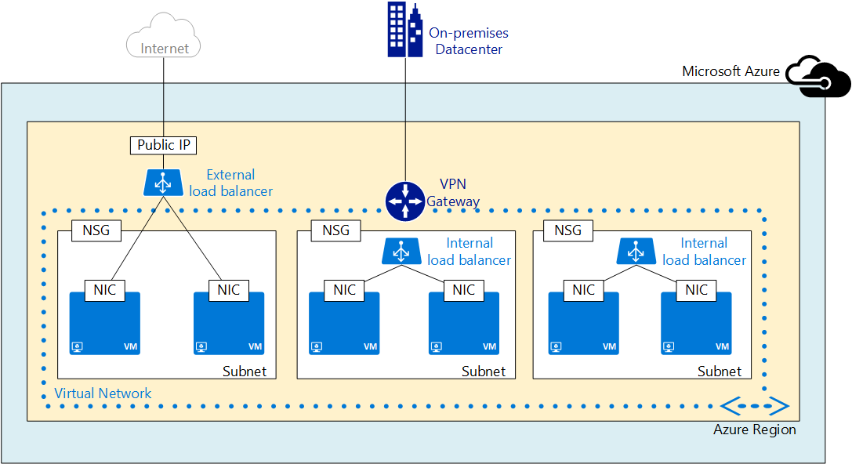
Azure Virtual Machine Networking Aspects
Azure Region
Virtual Network
Subnets
Network Security Groups
Network Interface Cards
Load Balancers
VPN Gateway

Slide 22
Contoso Ads Network for Lab 1
Virtual Network
Subnets
Network Interface Cards
Permit or Deny
Based on rulesets created
Network Security Groups (NSG)
Notes:
We’ll go into the Networking in more detail after the Lab and the break
Here’s a quick look at what you’ll be building in the Lab today

Slide 23
Introduction to Azure IAAS
Virtual Machines - Deployment

Slide 24
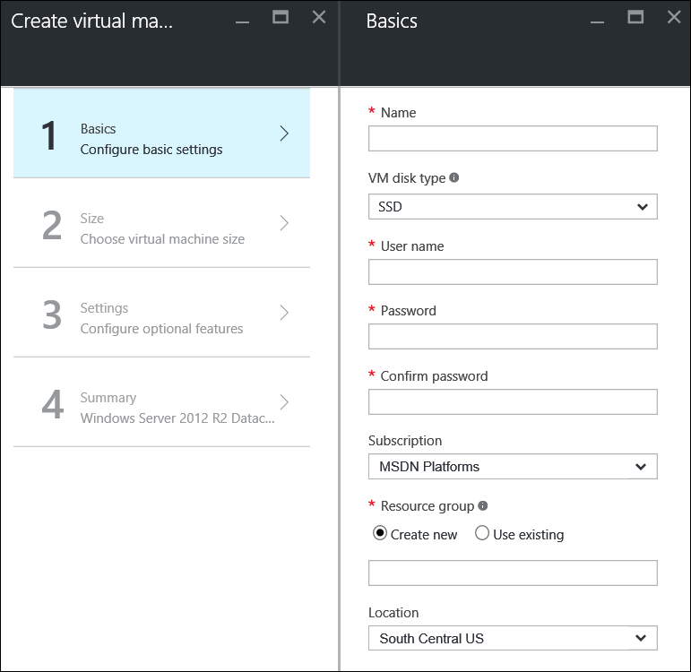
Deploying Azure Virtual Machines
1
2
Azure Management Portal
Command Line
PowerShell
New-AzureRmVM –ResourceGroupName $rg -VM $vm ...
CLI
az vm create --resource-group myResourceGroup --name myVM --image win2016datacenter --admin-username azureuser --admin-password myPassword12
3
SDK
Console.WriteLine("Creating virtual machine...");
azure.VirtualMachines.Define(vmName)
.WithRegion(location)
.WithExistingResourceGroup(groupName)
.WithExistingPrimaryNetworkInterface(networkInterface)
.WithLatestWindowsImage("MicrosoftWindowsServer",
...
4
API
"OSDisk": {
"EncryptionSettings": null,
"OperatingSystemType": "Windows",
"Caching": "ReadWrite",
"CreateOption": "FromImage",
...
5
Templates

Slide 25

Scaling IaaS Workloads
Scale up/down
Not automated by design (requires a reboot) as part of the auto-scale rules, but can be scripted with PowerShell
Scale up/down within the VM family. Scaling outside VM family requires deallocating the VM
Cannot scale down if you have more data disks attached than the lower size supports or if the instance size is not supported in the cluster your cloud service is created in
Scale out/in
VM Scale Sets allow manual or auto scale both in and out
Scale Up
Scale Down
Scale out
Scale in

Slide 26
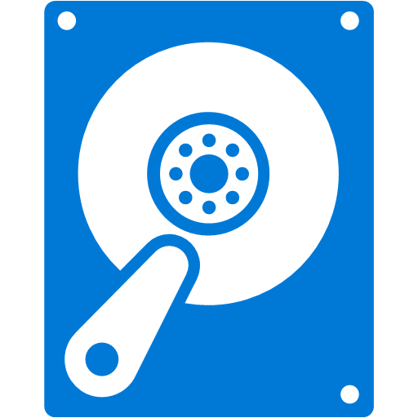
Virtual Machine Scale Sets
1 VM
Used for building large-scale and/or scalable services targeting:
big compute
big data
containerized workloads
Recommended approach
Scale Set VMs are configured identically
Custom images supported but limited to the same storage account
Integrates with Virtual Networks, Load Balancers and Network Security Groups
Not only for large scale (most are 2-10 vms)
1000 VMs
ATTACHED DATA DRIVES USING MANAGED DISKS

Slide 27
Introduction to Azure IAAS
Virtual Machines - Configuration

Slide 28

Virtual Machine Guest Agent
The Azure virtual machine agent is automatically installed on VMs created in the Azure Portal (optional on Windows).
When uploading VHD disks created you can install the agent agent file separately.
During deployment specify the agent is installed.

Slide 29
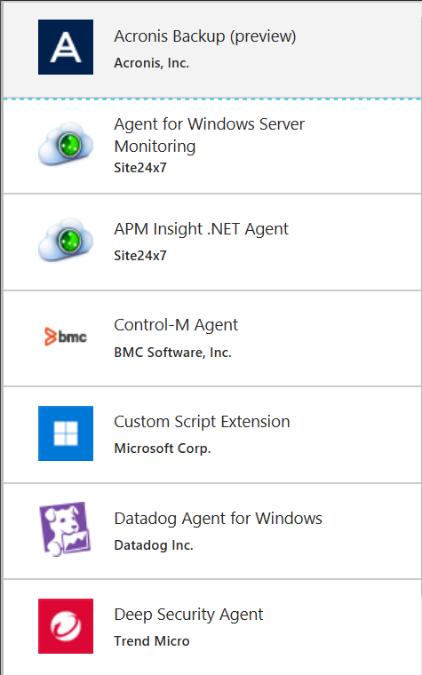
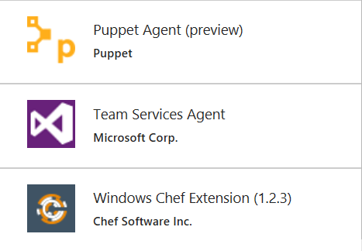
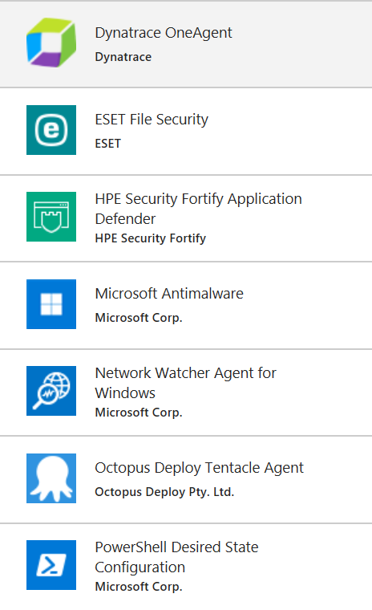
Virtual Machine Extensions
Extensions by Microsoft & third party
Extensibility points for Azure Virtual Machines
Security
Configuration Management
Access Control
Many Others
Execute from the portal, script, or as part of an ARM template.

Slide 30
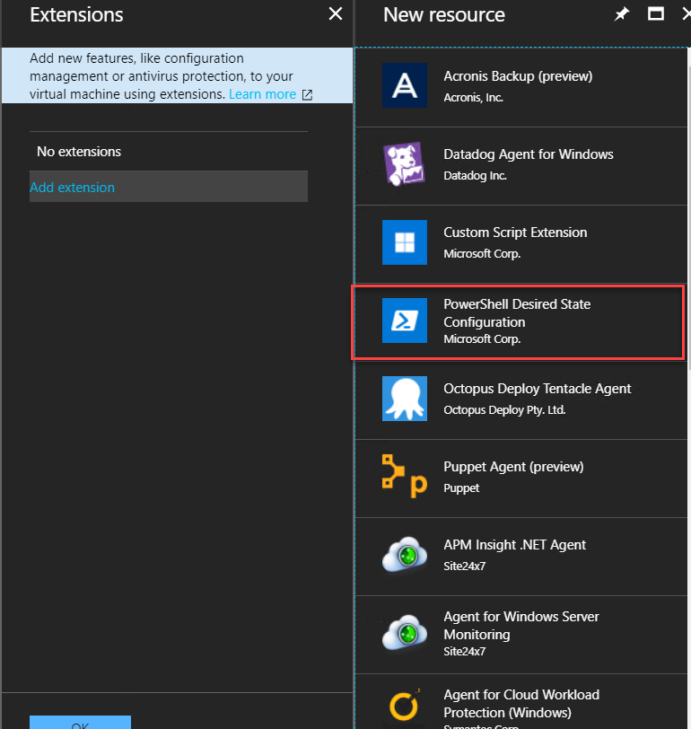
Virtual Machine Extensions
Desired State Configuration (DSC)
In today’s Lab we’ll use DSC to configure our Web Server to the desired state
Desired State Configuration:
Install the IIS feature
Install the ASP.NET 4.5 feature
Install applications required to meet our desired state (Contoso Ads)
https://docs.microsoft.com/en-us/azure/virtual-machines/windows/extensions-dsc-overview
Notes:
In our Contoso Ads example we will use the Powershell DSC Extension to configure our Web Server
When creating the VM Select the PowerShell Desired State Configuration (DSC) Extension for Azure VMs
The Azure DSC extension uses the Azure VM Agent framework to deliver, enact, and report on DSC configurations running on Azure VMs.
The DSC extension expects a .zip file containing at least a configuration document, and a set of parameters provided either through the Azure PowerShell SDK or through the Azure portal.

Slide 31
Introduction to Azure IAAS
Virtual Machines - Availability
Notes:
45 minute session

Slide 32
Virtual Machine Availability
Planned Downtime (Maintenance)
Updates made by Microsoft to the Azure fabric, that result in downtime
Leverage Action Groups to notify (SMS, email, webhook) the right people when maintenance requires reboots of your virtual machines
Unplanned Downtime
When the Azure datacenter hardware or physical infrastructure fails
Virtual machines are automatically migrated to a new physical host when failure is detected. This is known as “service healing”.

Slide 33
Availability Overview
Options
VM SLA
99.9% with Premium Storage
VM SLA
VM SLA
Rapid Recovery
99.95%
99.99%
Traffic Manager/ASR
Region 1
SINGLE VM
AVAILABILITY SETS / SCALE
SETS
AVAILABILITY ZONES
REGION PAIRS
Easier lift and shift
Protection from entire datacenter failures
Regional protection within Data Residency Boundaries
Protecting against failures within datacenters
Protection from…
Fire, flood, power and cooling disruption
Protection from…
Tornado, earthquake,
other large scale disasters
Protection from…
Hardware failure and software update cycles

Slide 34
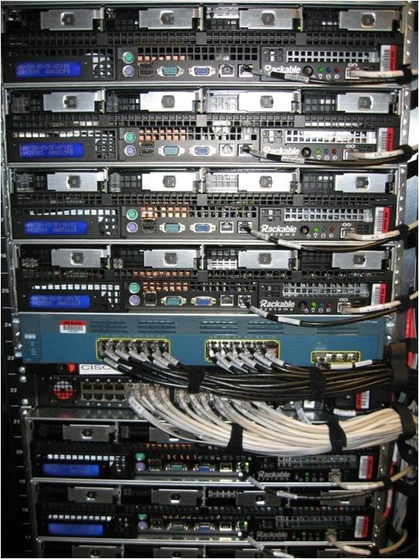

Availability sets
Physical machines
Power unit
Rack switch
VM1
VM2
VM2
VM1
Availability Set

Slide 35
Virtual Machine Availability Sets
Fault Domains
Update Domain
FD #0
UD #0
Up to 100 virtual machines
Fault Domains – isolate virtual machines for faults
Default setting = 2
Update Domains – isolate virtual machines for upgrades
Default setting = 5, can go up to 20
WEB-1
FD #1
UD #1
WEB-2
FD #2
UD #2
WEB-3
FD #0
UD #3
WEB-4
FD #1
UD #4
WEB-5
WEBAVSET

Slide 36

Managed Disks behavior with VM Availability Sets
AVAILABILITY SET
Managed disks honor fault domains within an availability set
Azure Fabric will deploy disks into storage accounts in the same fault domain as the virtual machines for additional physical redundancy
FAULT DOMAIN 0
FAULT DOMAIN 1
FAULT DOMAIN 2
STORAGE FAULT DOMAIN
STORAGE FAULT DOMAIN
STORAGE FAULT DOMAIN

Slide 37
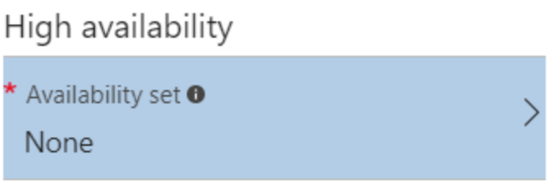
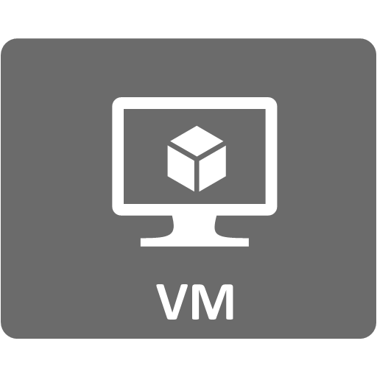
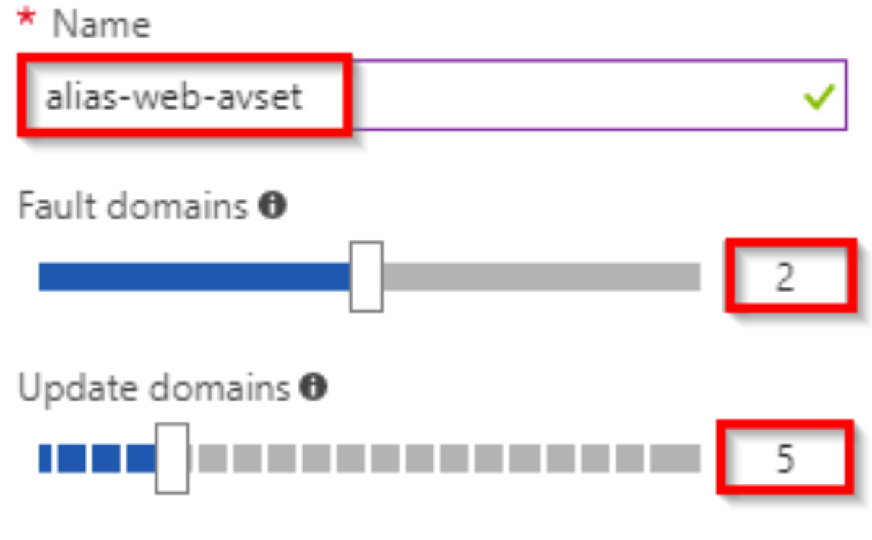
Virtual Machine Availability Sets
Fault Domains
Update Domain
FD #0
UD #0
WEB-1
In today’s Lab, from the Azure Portal you will deploy a single Contoso Ads Web Server in an Availability set of:
2 Fault Domains and
5 Update Domains
Allows deployment of future Web servers into the availability set
FD #1
UD #1
UD #2
UD #3
UD #4
Contoso Ads Web
Notes:
Availability Sets must be described at the time of server creation
Servers can’t be added to Availability sets after creation. Rather Servers need to be recreated

Slide 38
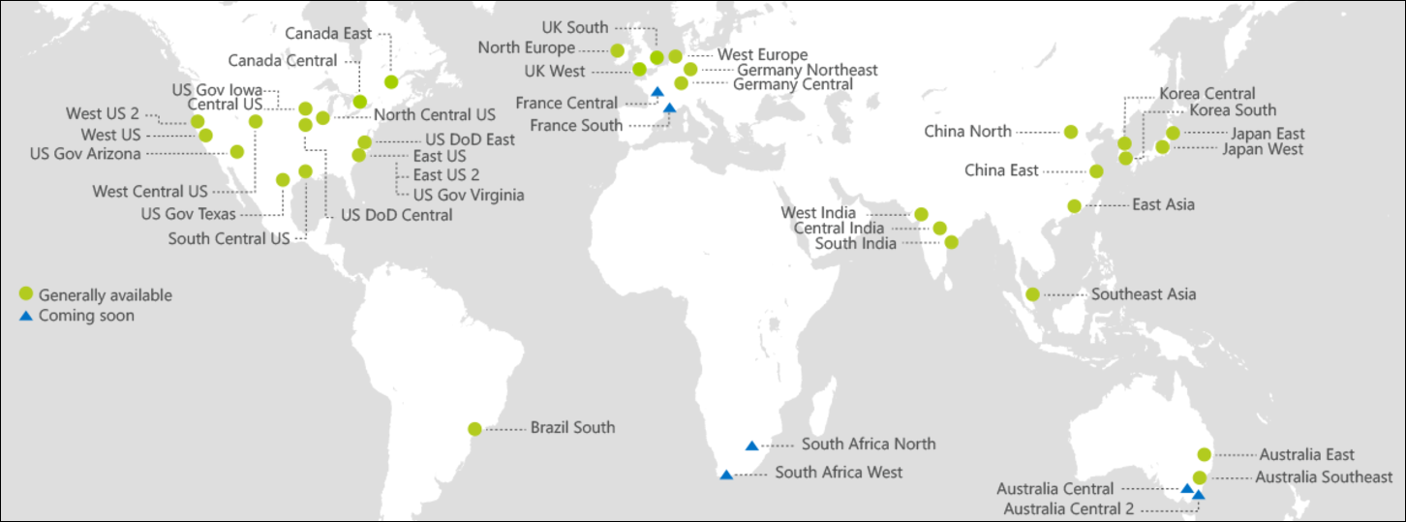
Azure Regions
42 Regions worldwide, with 36 Generally Available
MS Operates 100+ datacenters
Top 3 networks in the world
Second Largest Dark Fiber Network
China Operated by 21Vianet
Germany Operated by Deutsche Telekom
2x AWS, 4x Google DC Regions
Generally Available
Coming Soon
https://azure.microsoft.com/en-us/regions/

Slide 39
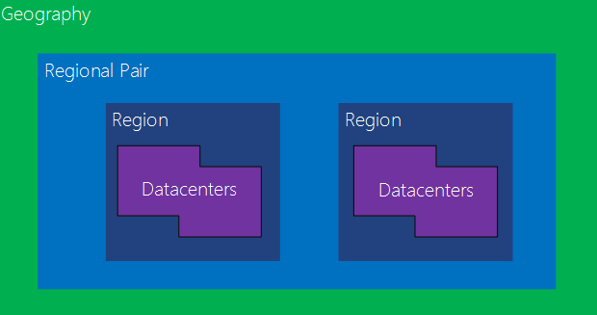
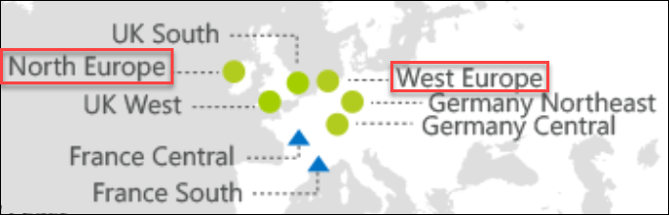
Azure Regions – Regional Paired Datacenters
Regions contain massive Microsoft owned and purpose-built Data Center(s) (DC)
DC’s have multiple layers of hardware and software redundancy for HA
Region to Region traffic travels over the Microsoft backbone
Region pairs in a geo-political area for cross-region DR scenarios
Example: North Europe and West Europe
Notes:
Allows for deployment for workloads in a geographically redundant way
All region pairs are located in the same geopolitical area
Data replication targets are selected within the regional pair where possible
System updates are never deployed to sister regions at the same time

Slide 40
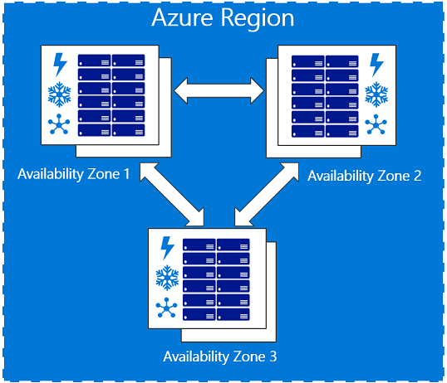
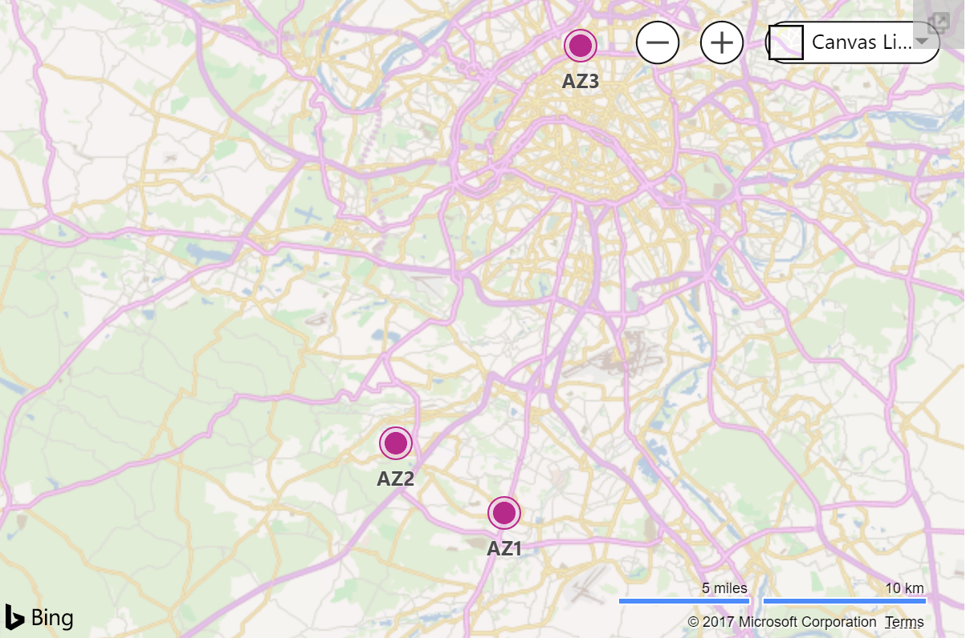
Availability Zones
Protect against datacenter-level failures
3 separate zones within each supported region
Independent power source, networking and cooling
Available in Supported Regions
France Central
Notes:
Availability Zones help to protect you from datacenter-level failures. They are located inside an Azure region, and each one has its own independent power source, network, cooling. To ensure resiliency, there's a minimum of three separate zones in all enabled regions. The physical and logical separation of Availability Zones within a region, protects applications and data from zone-level failures.
Supported RegionsAvailable in Supported Regions
East US 2
West Europe

Slide 41
Azure Networking
Introduction to Azure Networking
Notes:
1 hour 15 minute session

Slide 42
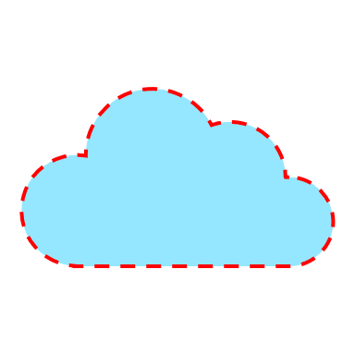
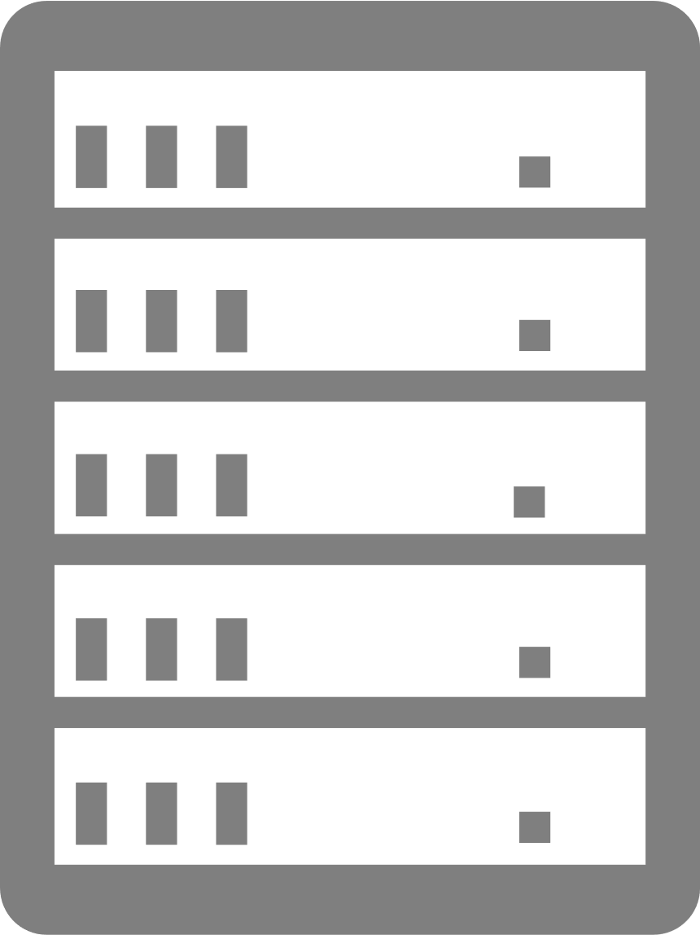







Request to a Server
www.xyz.com
www.eu.xyz.com
www.us.xyz.com

Slide 43
Request to a Server
www.xyz.com
www.eu.xyz.com
www.us.xyz.com

Slide 44

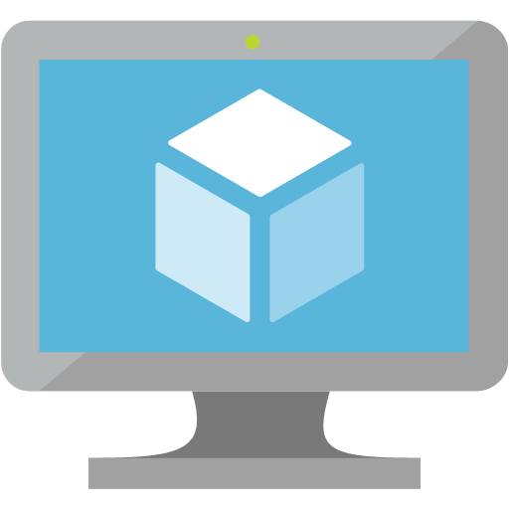






Azure Networking Overview
Users
Internet
Virtual Network
Bring your own network
Segment with subnets and security groups
Control traffic flow with user defined routes
Azure Virtual Network
Front-End Access
Dynamic/Reserved public IP addresses
Direct VM access, Inbound/outbound rules for security
Load balancing
DNS services: hosting, traffic management
Traffic Manager
DDoS protection
Backend connectivity
ExpressRoute
and
VPN
Vnet Access
Azure PaaS Services
MPLS
VPN
…
PaaS Services
Connect to PaaS services across the Azure backbone
Control access with service firewalls
Backend connectivity
Point-to-site for dev/test
VPN Gateways for secure site-to-site connectivity
ExpressRoute for private enterprise-grade connectivity
Notes:
Let’s set the stage: Azure provides the right connectivity for all scenarios.
<click>
The Virtual Network is the core of Networking in Azure. This bring your own network allows for full networking functionality using software defined networking. You can create subnets and secure traffic flow with Network security groups. User defined routes allows for discrete flow of traffic to the networks of your choice.
<click>
On the front end of the network Azure provides professional grade network capabilities for applications at scale. Load balancing and Traffic manager provide for dynamically moving traffic to points of presence around the world and seamless scaling.
<click>
Backend connectivity completes the networking picture allowing for seamless connections to corporate networks which makes hybrid cloud possible.
From scalability entry points all over the world; to Virtual Software Defined Networks in Azure; and VPN or MPLS connections which make the Microsoft Network just another WAN site. Azure truly is a world-class networking offering to public cloud.

Slide 45
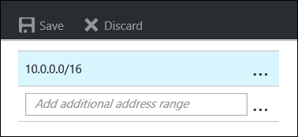
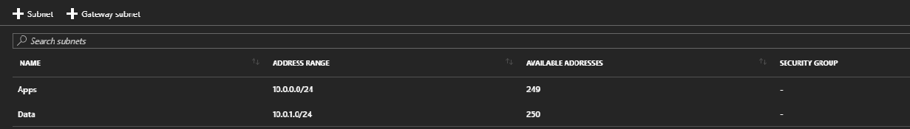
Defining a Virtual Network
Address Spaces and Subnets
Uses Classless Inter-Domain Routing (CIDR) notation
One more non-overlapping address spaces
Define subnets out of the available address spaces in the virtual network using Classless Internet Domain Routing (CIDR)
Address Spaces
Subnets
Notes:
Address Space created in the Contoso Ads VNET
Subnets created in the Contoso Ads VNET

Slide 46
Azure Provided Name Resolution
Built in DNS solution for Virtual Machines
No configuration is required
Highly available by design
Name resolution is provided between VMs in ARM-based virtual networks without need for the FQDN (*)
You can create the hostnames yourself
(*) classic virtual networks require the FQDN when resolving names
in different cloud services

Slide 47
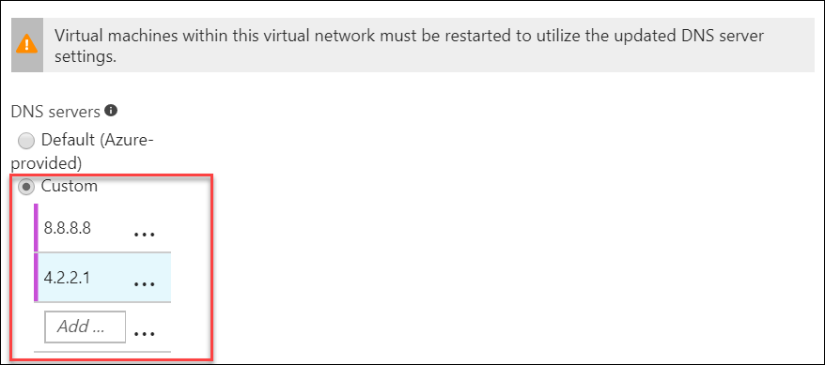

Bring your own DNS
Specify DNS Servers at the Virtual Network Level
Hosted in an Azure VM
External
On-Premises (with hybrid connection)
Virtual Machines are assigned specified DNS at boot
If DNS is added after a virtual machine is running, a reboot is required for assignment.
Virtual Network
Address Space: 10.0.0.0/16
DNS: 10.0.1.100 & 10.0.1.101
AD-VM-01
10.0.1.100
IIS-VM-01
10.0.2.4
AD-VM-02
10.0.1.101
IIS-VM-02
10.0.2.5
Subnet: AD
CIDR: 10.0.1.0/24
Subnet: WEB
CIDR: 10.0.2.0/24

Slide 48
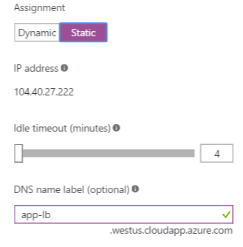
Public IP Address Assignment
A public IP can be assigned directly to a network interface or to a load balancer
Supports static (reserved) or dynamic assignment
Optionally supports specifying a DNS label
Configurable idle timeout
Reservation cost is free for the first 5 static IPs
Usage fee applies
vm1.westus.cloudapp.azure.com
23.100.44.180
app-lb.westus.cloudapp.azure.com
VM1
104.40.27.222
23.100.44.181
VM2
vm2.westus.cloudapp.azure.com
Notes:
Static Public IPs are charged for reservation fee ($0.004/hr) and usage fee ($0.004/hr). The first five static IP addresses are not charged for the reservation fee, but the usage fee still applies.
https://azure.microsoft.com/en-us/pricing/details/ip-addresses/

Slide 49
Azure Networking
Filtering Traffic

Slide 50
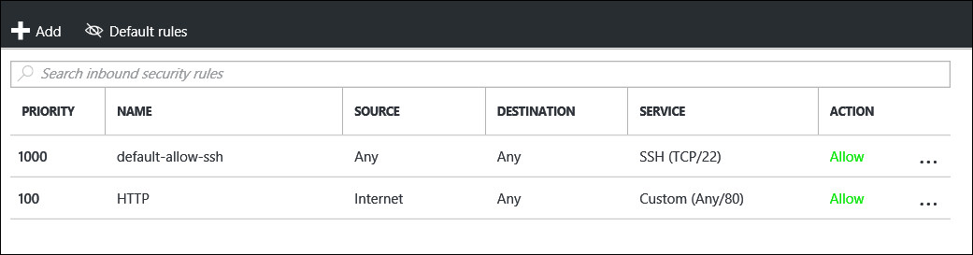
Network Security Groups - Overview
Protecting your network
Enables network segmentation & DMZ scenarios
NSG contains a list of rules that Allow/Deny Network Traffic to VMs in a Virtual Network
Restrict traffic from or to external or internal sources, but only within the region where it was created
Manage using Portal, Template, or Command line
Property | Limits
Number of NSGs associated to a subnet, VM, or Network Interface | 1
NSGs per region per subscription | 100*
NSG rules per NSG | 200*

Slide 51
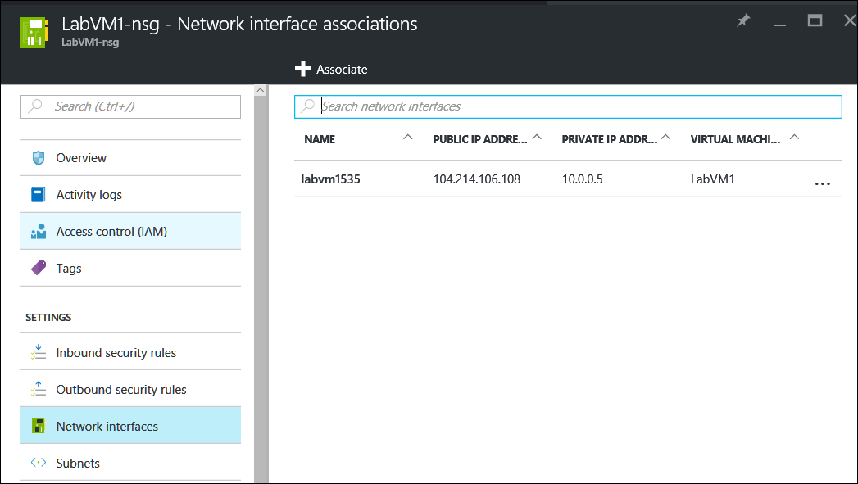
Network Security Groups - Association
Associate with a Network Interface or Subnet
Can associate an NSG with multiple subnets
All resources must reside in same virtual network

Slide 52
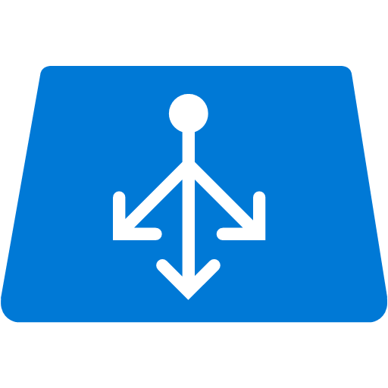

Stateful Firewall Rules using NSGs
Contoso Example
Virtual Network
Address Space: 10.0.0.0/16
Subnet App: 10.0.0.0/24
Allowed via Web-NSG SecurityGroup
Web-NSG SecurityGroup
SRC ADDRESS PREFIX: INTERNET
SRC PORT RANGE: *
DEST PORT RANGE: 80
DEST ADDRESS PREFIX: 10.0.0.0/24
WEB-VM1
Subnet Apps
10.0.0.4
WEB-VM2
Subnet Apps
10.0.0.5
WEB-VM3
Subnet Apps
10.0.0.6
WEB-VM4
Subnet Apps
10.0.0.7
Contoso Ads Customer
Allowed via SQL-NSG SecurityGroup
SQL-NSG SecurityGroup
SRC ADDRESS PREFIX: 10.0.0.0/24
SRC PORT RANGE: *
DEST PORT RANGE: 1433
DEST ADDRESS PREFIX: 10.0.1.0/24
Subnet Data: 10.0.1.0/24
Remember that OS Ports & Firewalls must be configured to allow traffic
SQL-VM1
Subnet Data
10.0.1.4
SQL-VM2
Subnet Data
10.0.1.5
SQL-VM3
Subnet Data
10.0.1.6
Notes:
An example based on our Contoso Ads Application
Instead of allowing everything in the 10.0.0.0/16 access to the SQL Databases (as we did in the lab), we could lock them down to just receive SQL Database requests from the Web Servers.
Note, as we did in the lab, the Servers and services on the server need to be configured to allow traffic (ie Port 1433 within the network)
This becomes more relevant as you add more and more subnets into the environment
Note that in the instance that multiple SQL servers are accessed, they would likely be clustered, load balanced and referenced as a single IP by the web servers

Slide 53
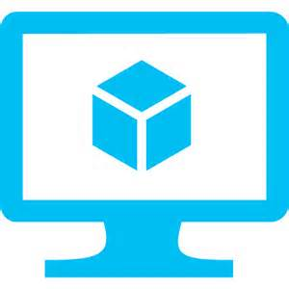
Virtual Appliances
Protecting your network
Internet
Overview
VMs that perform specific network functions
Focus: Security (Firewall, IDS , IPS), Router/VPN, ADC (Application Delivery Controller), WAN Optimization
Typically Linux or FreeBSD-based platforms
1st and 3rd Party Appliances
Scenarios
IT Policy & Compliance – Consistency between on premises & Azure
Supplement/complement Azure capabilities
Azure Marketplace
Available through Azure Certified Program to ensure quality and simplify deployment
You can also bring your own appliance and license
Network Virtual Appliance
Subnet
Notes:
Firewalls, Intrusion Prevention Systems, Intrusion Detection Systems, Load Balancers, Application Delivery Controllers, WAN Optimzers
All available in the marketplace

Slide 54
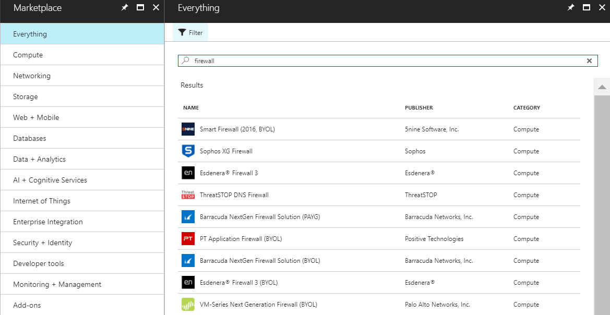
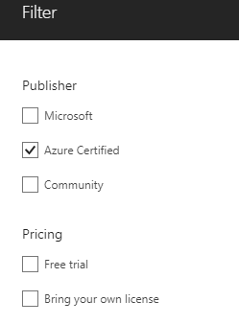
Azure Certified Firewalls from the Azure Marketplace
Bring Your Own License and Free Trial Solutions

Slide 55
Azure Networking
User-Defined Routing

Slide 56
Azure Routing
Default Behavior
Traffic automatically flows between virtual machines in different subnets and even address spaces
Azure has built in default routes:
Routing within a subnet
From a subnet to another subnet in the same virtual network
To the Internet
Virtual Network to Virtual Network using a VPN Gateway
Virtual Network to on-premises using a VPN Gateway

Slide 57
Azure Routing
User Defined Routes
Internet
Control traffic flow in your network with custom routes
Attach route tables to subnets
Specify next hop for any address prefix
Set default route to force tunnel all traffic to on-premises or appliance
Enable IP Forwarding to receive routed traffic
IP forwarding allows a virtual machine to accept traffic that is not originally destined for it
Virtual Network
VM with IP Forwarding
System
Route
FrontEnd Subnet
BackEnd Subnet
Default Route
VM/Appliance
User Defined Route
Notes:
Here we see the stand configuration for VNETs in azure. By default have traffic flowing into the network directly to the front-end of our application then traffic from those VMs to the backend subnet for Data from perhaps a SQL Server.
When using “User Defined Routes” the traffic is directed to other VMs first for processing.
In this case there could be a content switching appliance that is directing traffic to the correct VMs and then in the backend we might be putting the data through a Firewall to ensure that there isn’t malicious behavior happening in the traffic to ensure our data is secure.
For example we might not allow traffic from clients connecting to our data from outside of our country.

Slide 58



Forced Tunneling
On-Premise Network
Controlling outbound Internet traffic
Internet
Security Device
“Force” or redirect Internet-bound traffic to an on-premises site (per subnet)
Auditing & inspecting outbound traffic from Azure
Needed by many scenarios for critical security and IT policy requirements
Requires a Route-based Gateway
INTERNET - IPSEC
Virtual Network
Subnet BackEnd
Subnet FrontEnd

Slide 59
Azure Networking
Load Balancing

Slide 60



Load Balancing Options
Load Balancer
Basic and Standard SKU (Standard works across Availability Zones)
Application Gateway
Small, Medium and Large SKUs
Web Application Firewall available on Med./Lg. SKUs
3rd Party Solutions from Marketplace

Slide 61
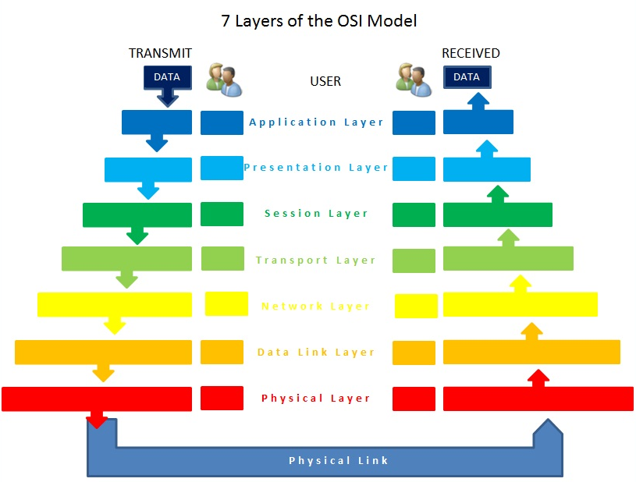
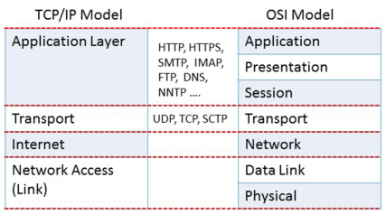
Load Balancing Options
Layer 4 Load Balancing
Layer 3 Load Balancing
Layer 7 Load Balancing
Notes:
A layer 3 load-balancer takes routing decisions based on IP addressing alone (source & destination).
A layer 4 load-balancer takes routing decision based on IPs and TCP or UDP ports. It has a packet view of the traffic exchanged between the client and a server which means it takes decisions packet by packet
At Layer 7, a load balancer has application awareness and can use this additional application information to make more complex and informed load balancing decisions. With a protocol such as HTTP, a load balancer can uniquely identify client sessions based on cookies and use this information to deliver all a clients requests to the same server. This server persistence using cookies can be based on the server’s cookie or by active cookie injection where a load balancer cookie is inserted into the connection. Free LoadMaster includes cookie injection as one of many methods of ensuring session persistence.
Layer 7 Persistence Methods
Server Cookie Persistence
Server Cookie persistence uses server generated cookies to establish the server to send users to. This method is sometimes referred to as “passive cookie”, as the load balancer only observes the cookie in the HTTP stream.
Active Cookie Persistence
The Active Cookie method is a Layer 7 feature that uses cookies generated by the load balancer, not the server. When a connection is established, the load balancer looks for an active cookie and if that cookie is not there, inserts it into the HTTP stream. Existing server and application cookies are not impacted.
Server Cookie with Source IP Persistence
If the expected server cookies aren’t present (e.g. if a browser is set to refuse cookies), then the source IP address will be used to determine persistence.
Active Cookie with Source IP Persistence
In this case if the expected Active cookies are not present, then the source IP address will be used to determine persistence.
Hash All Cookies Persistence
The ‘Hash All Cookies’ method creates a hash of all cookies in the HTTP stream. This calculated has is used to uniqiely identify client sessions and maintain persistence.
Hash All Cookies with Source IP Persistence
Hash All Cookies or Source IP is identical to Hash All Cookies, with the additional feature that it will fall back to Source IP persistence in the event that no cookies are in the HTTP string.
Source IP Address Persistence
Source IP Address persistence uses the source IP address of the client request to uniquely identify users. This is the simplest method of persistence, and works for all TCP protocols, including those that are not HTTP related. Source IP addess persistent can fail if multiple clients are coming from the same IP address as would be the case of multiple remote clients being behind a NAT device.
Super HTTP
Super HTTP is the recommended method for achieving persistence for HTTP and HTTPS services with LoadMaster load balancers. It creates a fingerprint based on the combined values of the User-Agent field and, if present, the Authorization header.

Slide 62
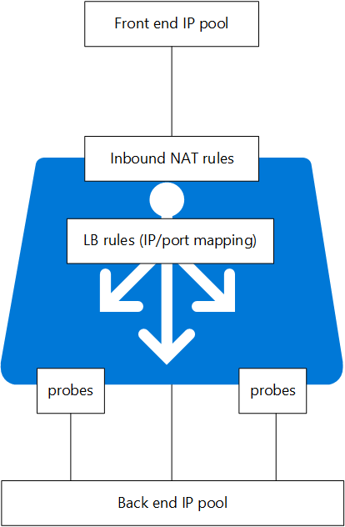
Azure Load Balancer
Load Balancing Solutions
“Typical Load Balancing” on Layer 4
External or Internal Load Balancing
Support for TCP and UDP Protocols
Health Probe (http or tcp)
NAT rules allow addressing specific VMs through the public IP on the load balancer front end
Useful with VM Scale Sets

Slide 63

Application Gateway
Load Balancing Solutions
Load Balancing
Cookie Affinity
Application Load Balancing on Layer 7
HTTP/HTTPS protocols only
Session cookie affinity
SSL offloading
URL rerouting
IIS-VM-01
App Gateway
HTTP & HTTPS
IIS-VM-02
SSL Offload
IIS-VM-03

Slide 64
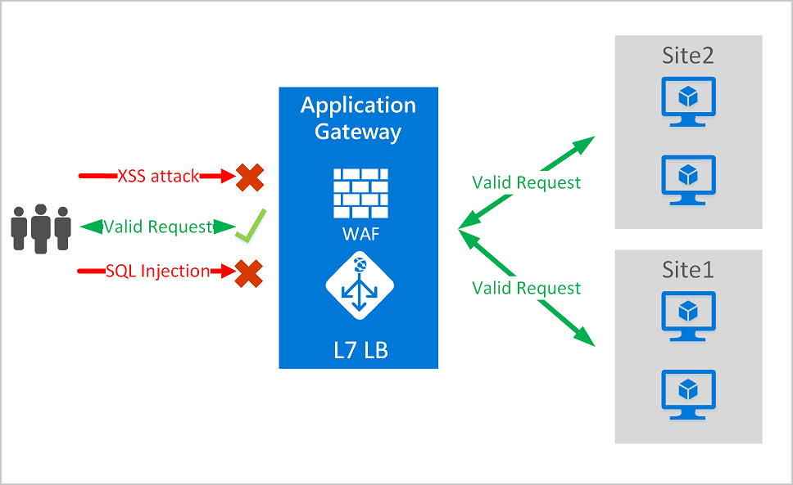
Application Gateway with WAF
Built in Protection
SQL injection protection
Cross site scripting protection
Common Web Attacks Protection such as command injection, HTTP request smuggling, HTTP response splitting, and remote file inclusion attack
Protection against HTTP protocol violations
Protection against HTTP protocol anomalies such as missing host user-agent and accept headers
Prevention against bots, crawlers, and scanners
Detection of common application misconfigurations (i.e. Apache, IIS, etc.)

Slide 65
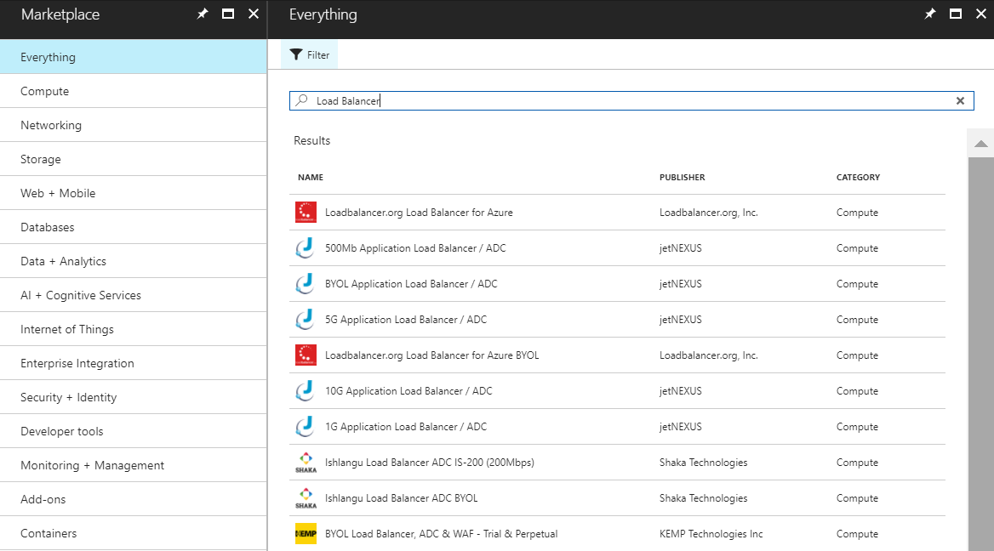
Azure Certified Load Balancers from the Azure Marketplace
Bring Your Own License and Free Trial Solutions

Slide 66
Azure Networking
DNS & Traffic Manager

Slide 67


DNS Services
Azure Traffic Manager
Azure DNS
Globally route user traffic with flexible policies
Enable best-of-class end to end user experience
Host your DNS domains in Azure
Integrate your Web and Domain hosting

Slide 68

Traffic Manager
DNS Based Traffic Distribution
Traffic Manager Profile
A globally-available resource (not dependent on a single Azure region)
Four Distribution Algorithms
Performance, Weighted, Priority (Fail Over), Geographic
Map your domain name to yourservice.trafficmanager.net with CNAME
www.contoso.com -> contosotm.trafficmanager.net
Direct traffic to any Internet-facing HTTP/S endpoint
contosoeast.eastus.azure.com
contosowest.westus.azure.com
host1.contoso.com
Built in HTTP, HTTPS, or TCP Health Probes for High Availability

Slide 69
Performance
Traffic Manager determines fastest route for the client and returns IP for the appropriate endpoint.
Location Portland, OR
contosotm.trafficmanager.net
Request for www.contoso.com
Response with IP for contosowest.cloudapp.net
Traffic Manager Calculates Hops…
Health Probes
contosowest.westus.azure.com
contosoeast.eastus.azure.com
IIS-VM-01
IIS-VM-02
IIS-VM-01
IIS-VM-02
West US
East US
Notes:
The performance load balancing algorithm works by determining the fastest route for the client and then returning the correct IP.
For example:
<Click>
If you have a client coming from Portland, Oregon ….
<Click>
… Traffic manager will calculate the hops between both endpoints and the user.
<Click>
Traffic Manager will respond with the IP address for the closest Azure Region.
<Click>
The client finally makes the service request with the resolved IP address.

Slide 70
Weighted
Traffic Manager returns IPs in a round robin fashion regardless of client location. Can configure weights on specific endpoints.
Location Portland, OR
contosotm.trafficmanager.net
Request for www.contoso.com
Traffic Manager Returns the Next IP
Could be West or East
Response with IP for contosoeast.eastus.azure.com
Health Probes
contosowest.westus.azure.com
contosoeast.eastus.azure.com
IIS-VM-01
IIS-VM-02
IIS-VM-01
IIS-VM-02
West US
East US
Notes:
The Round Robin load balancing algorithm just returns the IP address from the next Traffic Manager endpoint, regardless of the client’s location.
For example:
<Click>
If you have a client coming from Portland, Oregon …
<Click>
… Traffic Manager returns the next endpoint, which could point to either the West US or East US Azure Regions.
<Click>
Traffic Manager sends the IP address to the client, for the determined Azure Region, and then ….
<Click>
… the client makes the service request with the resolved IP.

Slide 71
Priority
Traffic Manager always returns the IP address of the primary endpoint unless it fails a health check. Often used as an Active/Passive configuration.
ALL Requests
contosotm.trafficmanager.net
ALL Requests
Request for www.contoso.com
Request for contoso.com
Response with IP for contosowest.westus.azure.com
Response with IP for contosoeast.eastus.azure.com
Health Probes
contosowest.westus.azure.com
contosoeast.eastus.azure.com
X
IIS-VM-01
IIS-VM-02
IIS-VM-01
IIS-VM-02
West US
East US
Notes:
The Failover load balancing algorithm returns the IP address for the primary site, unless there is an availability issue. If that happens, it will return the endpoint from one of the other endpoints in the failover order that you specify.
For example:
<Click>
A client requests contoso.com, and …
<Click>
… Traffic Manager responds with the IP address for contosowest.cloudapp.net.
<Click>
The client makes the request with the resolved IP.
<Click>
The primary endpoint in West US goes down, and Traffic Manager marks the endpoint as being “degraded.”
<Click>
When the next client request comes in …
<Click>
Traffic Manager responds with the IP address for contosoeast.cloudapp.net …
<Click>
… and the client makes the service request with the resolved IP address.

Slide 72
Geographic
Users are directed to specific endpoints (Azure, External or Nested) based on which geographic location their DNS query originates from.
US Based Users
contosotm.trafficmanager.net
Japan Based Users
Request for www.contoso.com
Request for www.contoso.com
Response with IP for contosowest.westus.azure.com
Response with IP for contosoje.japaneeast.azure.com
Health Probes
contosowest.westus.azure.com
contosoje.japaneast.azure.com
IIS-VM-01
IIS-VM-02
IIS-VM-01
IIS-VM-02
West US
Japan East
Notes:
Select 'Geographic' so that users are directed to specific endpoints (Azure, External or Nested) based on which geographic location their DNS query originates from. This empowers Traffic Manager customers to enable scenarios where knowing a user’s geographic region and routing them based on that is important. Examples include complying with data sovereignty mandates, localization of content & user experience and measuring traffic from different regions.

Slide 73
Azure Networking
Demo
Notes:
Launch Azure Portal
Log on to the azure portal
Inspect Traffic Manager Profile
Search for traffic manager profile
Select and launch ContosoAdsDemo traffic manager profile
Select Traffic View and notice the blue dots. Click on each and note the latency
Select Endpoints and review the endpoints
IP serving an endpoint
Launch a command window
Lookup the ip serving contosoadstest.trafficmanger.net
Ipconfig /flushdns
Nslookup contosoadstest.trafficmanager.net
Note the IP Address
Traffic Manager in action
Go back to the Traffic Manager blade
Disable the endpoint that was serving the app
Wait for some time (maybe talk) and then re-run the nslookup. Note the new IP address
Traffic Manager configuration
Select Configuration for traffic manager
Inspect the configs
TEST TRAFFIC MANAGER DEMO USING NSLOOKUP
Log Azure and review Traffic Manager Config – Look at Traffic View Map showing 2 End Points (Europe and US). Click End Points
https://ms.portal.azure.com/#resource/subscriptions/7adeba7f-4949-4201-b9c2-59283fcb5e11/resourceGroups/ContosoAdsDemo-2-CloudService/providers/Microsoft.Network/trafficmanagerprofiles/contosoads-demo-tm/endpoints
Open CMD Prompt
Flush DNS and check IP of endpoint for traffic manager
ipconfig /flushdns
nslookup http://contosoads-demo-tm.trafficmanager.net
*******response*****
C:\>nslookup contosoads-demo-tm.trafficmanager.net
Server: f5-2.redmond.corp.microsoft.com
Address: 10.50.10.50
Non-authoritative answer:
Name: ca-demo-web-vm1.westus2.cloudapp.azure.com
Address: 52.250.127.36
Aliases: contosoads-demo-tm.trafficmanager.net
*****
Log into Azure Traffic Manager-Endpoints- and disable the active endpoint you hit.
Flush and do NSLOOKUP AGAIN
C:\>ipconfig /flushdns
C:\>nslookup contosoads-demo-tm.trafficmanager.net
Server: f5-2.redmond.corp.microsoft.com
Address: 10.50.10.50
DNS request timed out.
timeout was 2 seconds.
Non-authoritative answer:
Name: contosoads-demo-westeurope-cs.cloudapp.net
Address: 52.174.243.78
Aliases: contosoads-demo-tm.trafficmanager.net
******
Highlight the change in end point showing Traffic Manager is working.
2. TCPING (install exe to system32) – Checking Port 80 is open
Open the Contoso Ads Test RG (for admins)
https://ms.portal.azure.com/#resource/subscriptions/7adeba7f-4949-4201-b9c2-59283fcb5e11/resourceGroups/ContosoAdsDemo-1-IaaS/overview
Explain that this is the Contoso IaaS deployment – Show that you can access the App Web Page
Open CMD Prompt and perform TCPing on http://ca-demo-web-vm1.westus2.cloudapp.azure.com
Show response describes port open
Click and open a web page to the ca-demo-web-vm1 to show Web App is up (click on the resource and then copy the DNS name into browser) – CLOSE
Click and Open the Network Secure Gateway for the Web Server - ca-demo-web-nsg
Update to DENY Port 80 and save
TCPing http://ca-demo-web-vm1.westus2.cloudapp.azure.com
Show RDP shut
TCPing –port 3389 http://ca-demo-web-vm1.westus2.cloudapp.azure.com
Open RDP on NSG and Show RDP open TCPing –port 3389 http://ca-demo-web-vm1.westus2.cloudapp.azure.com
3. FIDDLER (If Time Allows)
Open Fiddler and then open the Contoso Ads Application
Click into the ca-demo Contoso Apps session
Review the Result, Protocol, Host, URL and Size of Body information
Review statistics around the app including Estimated Worldwide performance Stats

Slide 74
Automate and Scale
Introduction to PaaS

Slide 75
Cloud Service Models
Traditional
On Premises
Infrastructure
(as a Service)
Platform
(as a Service)
Software
(as a Service)
You manage
Applications
Applications
Applications
Applications
Data
You manage
Data
Data
Data
Runtime
Runtime
Runtime
Runtime
Managed by vendor
You manage
Middleware
Middleware
Middleware
Middleware
Managed by vendor
O/S
O/S
O/S
O/S
Virtualization
Virtualization
Managed by vendor
Virtualization
Virtualization
Servers
Servers
Servers
Servers
Storage
Storage
Storage
Storage
Networking
Networking
Networking
Networking
Notes:
With Platform as a Service (PaaS), The hosting model is attractive because it delegates the responsibility for managing both the hardware and the operating system to the partner. In a recent white paper, David Chappell explained:
PaaS provides a higher-level foundation that hides irrelevant details. Building on PaaS lets development teams focus on what they really care about—their application—rather than on managing infrastructure.
With IaaS, the approach is more for IT Pros, since it involves extensive use of PowerShell. Because you configure your own VMs/VHDs, etc., this approach requires OS, networking, and all of their Sys Admin skills as well.
Microsoft Azure Virtual Machines is a new addition to IaaS provided by Microsoft Azure, offering an easier and flexible solution for:
Quickly moving an existing workload from on-premises to the cloud.
or
Building new applications that have dependencies on applications that will only run on a server with local persistent storage.

Slide 76

Common Reasons for PaaS
Reduce the time required to deploy and manage an application
Ease of Deployment
Services can be quicker and easier to deploy
and scale out
Ease of Management
Keep underlying software features up-to-date
Setting configuration and security policies
Patching and updates

Slide 77
Advantages of PaaS
Use sophisticated tools affordably. A pay-as-you-go model makes it possible for individuals or organizations to use sophisticated development software and business intelligence and analytics tools that they could not afford to purchase outright.
Cut coding time. PaaS development tools can cut the time it takes to code new apps with pre-coded application components built into the platform, such as workflow, directory services, security features, search, and so on.
Add development capabilities without adding staff. Platform as a Service components can give your development team new capabilities without your needing to add staff having the required skills.

Slide 78
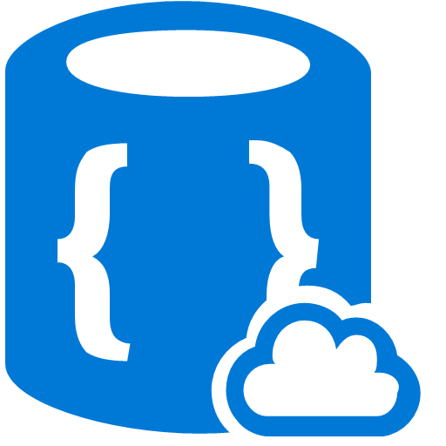




Platform as a Service
PaaS Service Offerings in Azure
PaaS designed expressly to support scalable, reliable, and low-admin applications. Azure offerings can be broken down into two categories.
Compute
Storage and Data Services
Notes:
We’re going to talk about the two main types of Azure PaaS offerings today. These services are combined to create applications in Azure
Types of Compute PaaS Services
Cloud Services
Web Apps
API Apps
Mobile Apps
Types of Storage and Data PaaS Services
Relational Database (RDBMS)
NoSQL:
Key-Value
Document
Graph
Column
Message Queues
File Storage / Object Storage

Slide 79
PaaS Compute

Slide 80





Azure Cloud Services, Serverless and Azure App Service
Azure Cloud Services
Allows developers access to the underlying virtual machines and still manages the application container and deployment automatically.
Microsoft still uses Azure Cloud Services internally.
Azure App Service and Serverless
Newer offering on Azure.
Azure takes care of application deployment and management.
Enables developer to concentrate on application development.
Notes:
First let’s differentiate between Azure’s numerous Services in this space…
Azure App Service is Azure’s newer managed platform service. This means that Azure takes care of application deployment and management, while the developer only needs to concentrate on app development. Azure App Service supports applications defined by Azure as “Web Apps”, “Mobile Apps”, “API Apps”
Azure Serverless – Is Azure’s newest offering that refers to Event Grid, Logic Apps and Functions
Azure Cloud Services was an earlier offering in Azure. It is a platform that allows developers access to the underlying virtual machines and still manages the application container and deployment automatically. This offers a more flexible solution than Azure App Service.
As there are a number of 1st party (internal) services built on Cloud Services, we are going to focus on Cloud Services today and then discuss App and Serverless in tomorrow’s session.

Slide 81
Introduction to Azure PAAS
Azure Cloud Services

Slide 82
What is a Cloud Service?
A collection of related service roles
Web Role
Worker Role

Slide 83
Web Roles
Pre-configured Windows Server
IIS Pre-Installed
Firewall open for port 80
Default Endpoint for port 80
You can run pretty much any IIS workload on it
Customizable with startup scripts

Slide 84
Web Roles
IIS 7, 7.5, 8.0 or 8.5 (2012 R2)
ASP.NET 3.5 SP1, 4.0 or 4.5+ – 64bit
Hosts
ASP.NET (Webforms or MVC)
FastCGI applications (e.g. PHP)
Multiple Websites
Support for HTTP and HTTPS (SSL)
Domain Name Mapping

Slide 85
Worker Roles
Pre-configured Windows Server
Nothing else installed
No default Azure endpoints
Run custom workloads that don’t require IIS
Install additional software, etc. using scripts
Implement Logic in the WorkerRole.cs class

Slide 86
Worker Roles
Worker code executes in WAWorkerHost process.
Queue Polling Worker
Poll and Pop Messages within while(true) loop
E.g. Map/Reduce pattern, background image processing
Listening Worker Role
Create TcpListener or WCF Service Host
E.g. Host a Java Service or WCF Service
External Process Worker Role
OnStart or Run method executes Process.Start()
Startup Task installs or executes background/foreground process
Custom Role Entry Point (executable or .Net assembly)
E.g. Run a database server, web server, distributed cache

Slide 87
Roles vs. Instances
Role (“Template”)
Configuration
OS Family (Server 2008, 2012)
VM Size
Role Type (Web, Worker)
Endpoints
Settings
Etc…
Code
Keep at least two instances running for improved fault tolerance and SLA. Load balanced Endpoints are automatically maintained.
Instance
*
Running VM, configured, with code deployed, endpoints opened, etc.

Slide 88
Working with Cloud Services Projects
Demo

Slide 89
Hands On Lab
Introduction to PaaS – Cloud Services

Slide 90
Scale Out
Add more instances for load balancing and improved fault tolerance when demand is high.
Role (“Template”)
Configuration
OS Family (Server 2008, 2012)
VM Size
Role Type (Web, Worker)
Endpoints
Settings
Etc…
Code
Keep at least two instances running for improved fault tolerance and SLA. Load balanced Endpoints are automatically maintained.
Scale Out
Instance
*
Running VM, configured, with code deployed, endpoints opened, etc.

Slide 91
Scale In
Role (“Template”)
Remove un-needed instances to save money when demand is low
Configuration
OS Family (Server 2008, 2012)
VM Size
Role Type (Web, Worker)
Endpoints
Settings
Etc…
Code
Keep at least two instances running for improved fault tolerance and SLA. Load balanced Endpoints are automatically maintained.
Scale In
Instance
*
Running VM, configured, with code deployed, endpoints opened, etc.

Slide 92
Cloud Service Web and Worker Role VMs
Preconfigured Virtual Machines (VMs)
Running Windows Server 2012 R2, 2012, or 2008
You DO NOT need to install the OS
You DO NOT need to maintain the OS
Azure monitors the VMs and will restart any that fail
They are STATELESS
When a VM is recycled, no data is preserved
Data in local storage (local to the VM) will be lost as there is no direct persistent storage
Persist data in Table or Blob Storage or SQL Azure
Role Virtual Machines
Notes:
These instances are different from Azure VMs
Azure itself manages these instances
OS/component patches
Automatic rollout of new patches images
Azure also monitors the VMs and restarts any that fail
Using Cloud Services - Your app does not maintain state in web or worker roles – Stateless

Slide 93




Cloud Service Topology
End User
Cloud Service
Service Admin
Web Roles
Worker Roles
Storage
Database

Slide 94
Introduction to PaaS
Introduction to Azure Storage and Data Services

Slide 95

Azure Storage
Storage Accounts
Container for storage services
Namespace for storage services
Region bound
Durability and high availability boundary
Locally-, geo-, or read-access geo-redundant storage
Security boundary
Access boundary
Notes:
Notes:
At the highest level of Azure Storage is the storage account. This is a named entity specified in a specific Azure region with its own scalability targets.
Storage accounts support different capabilities for automatic replication across regions. Storage accounts also service the purpose of a security boundary.
An Azure storage account gives you access to the Azure Blob, Queue, Table, and File services in Azure Storage. Your storage account provides the unique namespace for your Azure Storage data objects. By default, the data in your account is available only to you, the account owner.
There are two types of storage accounts:
Standard Storage Account
Premium Storage Account
References:
https://azure.microsoft.com/en-us/documentation/articles/storage-introduction/

Slide 96
Referencing Storage
Storage Accounts
Blob Storage
Table Storage
Queue Storage
Azure Subscription
Blob Containers
Blobs
Tables
Entities
Queues
Messages
File Service
Shares
Files and Folders
Notes:
Notes:
Every object that you store in Azure Storage has a unique URL address. The storage account name forms the subdomain of that address. The combination of subdomain and domain name, which is specific to each service, forms an endpoint for your storage account.
Each storage account exposes endpoints for the different services (Blob, File, Table and Queues). Each service is further subdivided into separate entities.
1. Blob:
Azure Blob storage is a service for storing large amounts of unstructured data, such as text or binary data, that can be accessed from anywhere in the world via HTTP or HTTPS. You can use Blob storage to expose data publicly to the world, or to store application data privately.
It has the following components-
Container: A container provides a grouping of a set of blobs. All blobs must be in a container. An account can contain an unlimited number of containers. A container can store an unlimited number of blobs.
Blob: A file of any type and size. Azure Storage offers three types of blobs: block blobs, page blobs, and append blobs.
2. File:
File Services contains SMB shares, which of course contain traditional files and folders.
It has the following components-
Share: A File storage share is an SMB file share in Azure. All directories and files must be created in a parent share. An account can contain an unlimited number of shares, and a share can store an unlimited number of files, up to the 5 TB total capacity of the file share.
Directory: An optional hierarchy of directories.
File: A file in the share. A file may be up to 1 TB in size.
3. Table:
The Azure Table storage service stores large amounts of structured data. The service is a NoSQL data store which accepts authenticated calls from inside and outside the Azure cloud. Azure tables are ideal for storing structured, non-relational data.
It has the following components-
Table: A table is a collection of entities. A single table can contain entities that have different sets of properties. The number of tables that a storage account can contain is limited only by the storage account capacity limit.
Entity: An entity is a set of properties, similar to a database row. An entity can be up to 1MB in size.
4. Queue-
It is a service that provides messaging queues in the cloud. It is a service for storing large numbers of messages that can be accessed from anywhere in the world via authenticated calls using HTTP or HTTPS.
It has the following components-
Queue: A queue contains a set of messages. All messages must be in a queue.
Message: A message, in any format, of up to 64KB.
References:
https://azure.microsoft.com/en-us/documentation/articles/storage-create-storage-account/#storage-account-endpoints
https://azure.microsoft.com/en-us/documentation/articles/storage-dotnet-how-to-use-blobs/
https://azure.microsoft.com/en-us/documentation/articles/storage-dotnet-how-to-use-tables/
https://azure.microsoft.com/en-us/documentation/articles/storage-dotnet-how-to-use-queues/
https://azure.microsoft.com/en-us/documentation/articles/storage-dotnet-how-to-use-files/

Slide 97
Azure Storage Durability Types
Durability Type | Description
Locally Redundant Storage (LRS) | 3 copies within a single datacenter
Zone Redundant Storage (ZRS) | 3 copies across multiple datacenters within a region
Geographically Redundant Storage (GRS) | 3 copies within a single datacenter 3 copies in a second datacenter in another region
Read-Access Geographically Redundant Storage (RA-GRS) | 3 copies within a single datacenter 3 copies in a second datacenter in another region Read-Access to secondary datacenter copies

Slide 98


Locally Redundant Storage (LRS)
Azure Storage Account
in Azure Region
Application / Service
Secondary
Primary
Secondary

Slide 99
Geo-Redundant Storage (GRS)
Azure Storage Account
in Primary Region
Azure Storage Account
in Secondary Region
Application / Service
Secondary
Secondary
Primary
Primary
Secondary
Secondary
Read-Access Geo-Redundant Storage (RAGS) works the same, but with a readable Secondary copy.

Slide 100
Blob Storage
Storage Type: File Storage / Object Storage
Blob Storage
Designed to store large amounts of data in the cloud
Unstructured data
Scenarios include document, images, videos, logs, backup files, etc.
Data stored as blobs
Blobs grouped as blob containers
Security and data access
Access blobs via REST APIs

Slide 101
Storage Queues
Storage Type: Message Queue
Queues
Designed to store large amounts of data for asynchronous communication between decoupled application components
Common use cases
Creating a backlog of work to process asynchronously
Cross service communication
Notes:
Notes
Send a message of data (64k per message) that can be processed by another part of the application.
For example, a web application submits a request to a queue (order or in our case provision a new tenant) and a separate process (worker role, WebJob) process the message)
Provide asynchronous communications between application components or systems
Decouple dependencies
Intermediate store for messages with guaranteed delivery
Supports multiple message Senders and Receivers

Slide 102
File Storage
Storage Type: File Storage
Files Storage
SMB 3.0 based
Mount file shares from VMs in Azure or on-premises (with appropriate ports open)
Create up to 5TB file shares
Manage with:
PowerShell, Portal, Rest API, CLI

Slide 103
Table Storage
Storage Type: Key-Value
Table Storage allows you to store flexible datasets that are not constrained by a schema
Built for massive scale (very large datasets)
Data is partitioned using a partition key to support load balancing across different nodes.

Slide 104
Types of Storage
Moving beyond Azure Storage accounts
File Storage / Object Storage (BLOB)
Message Queues
NoSQL
Key-Value Table Storage
Document
Graph
Column
Relational Database (RDBMS)
Notes:
There are many different types of storage available for use. The most common by far are Relational Databases. These would be SQL Server, Oracle, MySQL, and other database engines that are most often the default “goto” database storage used for the vast majority of applications.
Then there are NoSQL stores. These provide different mechanisms for storage and retrieval of data that is modeled differently that a Relational Database. The 4 main types of NoSQL stores are Column, Document, Key-Value, and Graph. We’ll get into what each of these are in a little bit.
Then there are other storage mechanisms, such as Message Queues and File Storage.
Let’s start digging into what each of these are.

Slide 105
What is NoSQL?
Store data differently than Relational Databases
Some use SQL-like query syntax
Have existed since the 1960’s
Not referred to as “NoSQL” until recently
Used increasingly for Big Data and Real-Time application scenarios
Enable “Internet scale” / Extremely High Scalability
Generally Distributed Systems
Notes:
NoSQL databases provide mechanisms for the storage and retrieval of data that is modeled differently than Relational Databases. Even though the name implies “non-SQL”, many NoSQL databases do support a SQL-like syntax. The NoSQL name is more of a reference to “non-relational” or “not only SQL”. It’s a name that calls out that it’s not a traditional Relational Database.
NoSQL databases have existed since the 1960’s, but they weren’t called “NoSQL” until the early 21st century with the rise of Big Data and the growth of Internet companies such as Facebook, Twitter, Google, and Amazon.
NoSQL databases are often used to reach higher levels of scale more easily than with Relational Databases, and really enable enterprises to reach the High Scale, sometimes referred to as “Internet scale”, that is required for Big Data and Real-Time application and analysis scenarios.
One of the ways many NoSQL systems are able to achieve high scale, outside of storing data differently, is to be built as distributed systems spread across multiple server or nodes.
SOURCE:
https://en.wikipedia.org/wiki/NoSQL

Slide 106
Relational Database
Tables of data with Rows of Columns
Set schema defining number of columns and data types
Table Relations
Primary Key / Foreign Key relationships link tables
SQL Queries
SELECT, INSERT, UPDATE, JOIN, UNION, WHERE, GROUP BY, ORDER BY, etc
Programmability
Stored Procedures, User-Defined Functions, Triggers
Well defined Schema
Notes:
Relational Databases are the most commonly used form of data storage. Data is stored in Tables with Rows of Columns; with a well defined schema defining the number of columns and their data types. These databases support querying using the Structured Query Language, or SQL. The relationships between tables and rows are managed through the use of Primary Key and Foreign Key relationships. Data across these relationships can be easily queried and the data joined together using the SQL languages. There also capabilities to implemented programming within the database using Stored Procedures, User-Defined Functions, and Triggers.
Relational Databases are generally the most common “goto” database used for all types of projects. However, they are not the only mechanism of database storage available, and it’s possible they may not be the best fit for a particular dataset or usage scenario.
Considerations
Require Transactional updates
Tabular data structure
Well defined schema
Relational queries
Example Uses
Financial data
Orders data
Customer data

Slide 107

Azure Cosmos DB
Globally distributed, multi-model database service
Supports all 4 types of NoSQL
Built natively for the cloud
Built for scale
Guarantees single-digit millisecond latencies
Notes:
Azure Cosmos DB is a native cloud service. It’s not simply a database engine you could run in a VM, but hosted as a cloud service instead. Azure Cosmos DB was built from the ground up to take full advantage of the capabilities of the Microsoft Azure cloud. That means global distribution, high scalability, and high availability are core features built into Cosmos DB from the ground up.
The service guarantees single-digit-millisecond latencies at the 99th percentiles anywhere in the world.
LINKS:
https://azure.microsoft.com/en-us/services/cosmos-db/

Slide 108
Azure Cosmos DB
Distributed NoSQL Database
Supported NoSQL Data Models
Document
Key-Value
Graph
Column
Multiple API Support
MongoDB
DocumentDB SQL
Gremlin
Azure Tables
Notes:
In the Azure Portal, Document DB is rebranded and shown as Azure Cosmos DB now.
Links:
https://docs.microsoft.com/en-us/azure/cosmos-db/introduction

Slide 109

Azure Cosmos DB
NoSQL Document Storage
Fully Managed NoSQL Document-based Database Service
Automatic and consistent indexing of all properties
Tunable High Performance
Backed by write-optimized SSD
Easy to scale globally
Native Support for JSON and JavaScript
Designed for the Cloud
Notes:
Produce and consume data at a staggering rate while requiring near instantaneous response times to match user expectations
Developed iteratively with many versions supported concurrently and continuously evolving data models
Increasingly complex, compensating for the lack of query and transactional processing in today’s NoSQL database systems
Experience unpredictable and explosive growth

Slide 110
Relational Databases: Azure SQL Database
Azure SQL PaaS Offering
Delivers Database-as-a-Service functionality, based on SQL Server and hosted in Microsoft Azure
Predictable performance, scalability, business continuity, elastic scale, data protection, minimal administration, and familiar tools

Slide 111

Azure SQL Database
Design and Management
Use Familiar Tools
Azure Management Portal
Visual Studio
PowerShell
SQL Server Management Studio

Slide 112

Azure SQL Database
Servers
Databases
Logical servers
Database containers
Security containers
Credentials
Firewall rules
Connection endpoints
Auto-generated FQDN
xxx.database.windows.net
Share logical server settings
Service tier
Performance level

Slide 113


Contoso Ads Cloud Service Topology

Slide 114
Hands On Lab
Introduction to PaaS – Cloud Services

Slide 115
Introduction to Azure Resource Manager (ARM)

Slide 116
Azure Resource Manager…
I want to grant a granular level of access to only specific things
I want a way to organize my resources in units that share a similar lifecycle
I want to attach my own nomenclature to resources to track business unit owner, environment, etc.
I want to accomplish declarative deployments using rather than traditional declarative, script-based approaches
I want to control what can happen in my subscription, such as what resources are supported, where they can be deployed, etc.

Slide 117

Azure Resource Manager
Azure Resource Manager or ARM is the one consistent method for managing Azure
Notes:
ARM is the underlying tooling that allows for the provisioning, securing and deployment of Azure Resources.

Slide 118



What can you do with Resource Manager?
Organize
Control
Deploy
Notes:
There are three experiences that Azure Resource Manager helps with.
Deployment: Offering a consistent and repeatable process to not just deploy one resource such as a virtual machine, but to also model an entire application and all of the resources that make up that application.
Organize: ARM provides resource groups to help you group resources by a shared lifecycle. So all of the resources that go with an application are in the same group.
ARM also provides tags, which allows a higher level of abstraction so you can group resources or resource groups into whatever grouping you require.
Examples of tags could include tagging resources by the environment they belong to, such as a development, test, or production, or even at a cost center level such as the marketing department.

Slide 119

What can you do with Resource Manager?
Organize
Control
Deploy
Notes:
There are three experiences that Azure Resource Manager helps with.
Deployment: Offering a consistent and repeatable process to not just deploy one resource such as a virtual machine, but to also model an entire application and all of the resources that make up that application.
Organize: ARM provides resource groups to help you group resources by a shared lifecycle. So all of the resources that go with an application are in the same group.
ARM also provides tags, which allows a higher level of abstraction so you can group resources or resource groups into whatever grouping you require.
Examples of tags could include tagging resources by the environment they belong to, such as a development, test, or production, or even at a cost center level such as the marketing department.

Slide 120

Resource Groups
Collection of resources with the same lifecycle
Every resource belongs to a resource group (and only one resource group)
Resources have types, defined by resource providers
Role based access control
Notes:
ARM works with a construct called a resource group.
Azure Resource Groups are logical containers that contain resources that share the same life cycle.
Each resource will belong to one and only one resource group.
A resource group can have resources in multiple regions.
Essentially, resources that should be created and deleted together should go in the same resource group. Where resources that other applications depend on, like a shared virtual network would go into a separate resource group.

Slide 121


Moving Resources
WebAppsRG
Resources can be moved between subscriptions or resource groups
Subscriptions must use same Azure AD tenant to move between subscriptions
Move resources by the portal or command line tools
Not all services support being moved
hrweb
HRAppRG
SQLDBRG
hrweb
hrdb
hrdb
hrstorage
https://aka.ms/immovableservices
StorageRG
hrstorage
Notes:
Resources can be moved between resources groups as along as they are in the same subscription or if in different subscriptions they both use the same Azure Active Directory Tenet. Not all resources can be moved from one RG to another RG, so it is important to read the documentation prior to starting the move.

Slide 122

Tags
User Supplied Meta-data
environment: Production
cost-center: Procurement
Name-value pairs assigned to resources or resource groups
Subscription-wide taxonomy
Each resource can have up to 15 tags
Tags roll up to your Azure bill
Query able via command line, portal or API
Use of tags can be enforced via policies
ProcurementRG
Web
SQL
environment: Production
cost-center: Procurement
workload: Web
environment: Production
cost-center: Procurement
Workload: SQL
Notes:
Tags are used to apply meta-data in the form of KEY:VALUE pairs. Read bullets.

Slide 123
What can you do with Resource Manager?
Organize
Control
Deploy
Notes:
There are three experiences that Azure Resource Manager helps with.
Deployment: Offering a consistent and repeatable process to not just deploy one resource such as a virtual machine, but to also model an entire application and all of the resources that make up that application.
Organize: ARM provides resource groups to help you group resources by a shared lifecycle. So all of the resources that go with an application are in the same group.
ARM also provides tags, which allows a higher level of abstraction so you can group resources or resource groups into whatever grouping you require.
Examples of tags could include tagging resources by the environment they belong to, such as a development, test, or production, or even at a cost center level such as the marketing department.

Slide 124

Role Based Access Control
Controlling Resources through Policy
Define who can perform what actions on what resources
Users and groups are added to roles
Roles are then applied at the subscription, resource group or resource level
Access is inherited from parent resources
Notes:
Notes:
Overview
Azure Resource Manager now allows you to control access through custom policies. With policies, you can prevent users in your organization from breaking conventions that are needed to manage your organization's resources.
You create policy definitions that describe the actions or resources that are specifically denied. You assign those policy definitions at the desired scope, such as the subscription, resource group, or an individual resource.
In this article, we will explain the basic structure of the policy definition language that you can use to create policies. Then we will describe how you can apply these policies at different scopes and finally we will show some examples of how you can achieve this through REST API.
Policy is currently available as a preview.
How is it different from RBAC?
There are a few key differences between policy and role-based access control, but the first thing to understand is that policies and RBAC work together. To be able to use policy, the user must be authenticated through RBAC. Unlike RBAC, policy is a default allow and explicit deny system.
RBAC focuses on the actions a user can perform at different scopes. For example, a particular user is added to the contributor role for a resource group at the desired scope, so the user can make changes to that resource group.
Policy focuses on resource actions at various scopes. For example, through policies, you can control the types of resources that can be provisioned or restrict the locations in which the resources can be provisioned.
https://azure.microsoft.com/en-us/documentation/articles/resource-manager-policy/

Slide 125


Identity comes from Azure AD
Azure Resources
Authentication
& Authorization
Users
Groups
Subscription
Resource
Groups
Resources
Service Principals
Azure Subscription
Azure Active Directory
Notes:
Here we see the relationship between Identity in Azure AD and RBAC. Users and Groups that live in Azure AD can be used to provide privileges in Azure for administration purposes.

Slide 126
Controlling Resources within a Subscription
Comparing Policies and RBAC
Role Based Access Control
Manage which users or groups can perform which actions on which resources
Examples
Owner
Contributor
Reader
Resource specific roles like Storage Account Contributor
Custom Roles
ARM Policies
Manage what resources or configurations are available at the subscription, resource group or resource level
Examples
Supported Regions
Naming Conventions
Supported Services
Supported SKUs
Tag requirements

Slide 127

Resource Manager Policies
Controlling Resources through Policy
Define what actions are allowed
Polices are a default allow system
Policies are described via Policy Definitions
Policies are applied via Policy Assignments
Scoped at:
Subscription
Resource Group
Resource
Notes:
Notes:
Overview
Azure Resource Manager now allows you to control access through custom policies. With policies, you can prevent users in your organization from breaking conventions that are needed to manage your organization's resources.
You create policy definitions that describe the actions or resources that are specifically denied. You assign those policy definitions at the desired scope, such as the subscription, resource group, or an individual resource.
In this article, we will explain the basic structure of the policy definition language that you can use to create policies. Then we will describe how you can apply these policies at different scopes and finally we will show some examples of how you can achieve this through REST API.
Policy is currently available as a preview.
Detailed Chargeback
Controlling services by region
Creating a service catalog
Enforcing naming convention
Tag Requirements
Supported resource types
VM Images
Instance Sizes
Premium or Standard Storage
How is it different from RBAC?
There are a few key differences between policy and role-based access control, but the first thing to understand is that policies and RBAC work together. To be able to use policy, the user must be authenticated through RBAC. Unlike RBAC, policy is a default allow and explicit deny system.
RBAC focuses on the actions a user can perform at different scopes. For example, a particular user is added to the contributor role for a resource group at the desired scope, so the user can make changes to that resource group.
Policy focuses on resource actions at various scopes. For example, through policies, you can control the types of resources that can be provisioned or restrict the locations in which the resources can be provisioned.
https://azure.microsoft.com/en-us/documentation/articles/resource-manager-policy/

Slide 128
What can you do with Resource Manager?
Organize
Control
Deploy
Notes:
There are three experiences that Azure Resource Manager helps with.
Deployment: Offering a consistent and repeatable process to not just deploy one resource such as a virtual machine, but to also model an entire application and all of the resources that make up that application.
Organize: ARM provides resource groups to help you group resources by a shared lifecycle. So all of the resources that go with an application are in the same group.
ARM also provides tags, which allows a higher level of abstraction so you can group resources or resource groups into whatever grouping you require.
Examples of tags could include tagging resources by the environment they belong to, such as a development, test, or production, or even at a cost center level such as the marketing department.

Slide 129


ARM Templates
Infrastructure as Code
JSON file listing the resources (and their dependencies) that ought to make up the deployment
Tells Azure “What to Create” (declarative)

Slide 130

Parameter Files
azure-deploy.json
Define Runtime Parameter Files for different environments
Used to store settings specific to an environment
Could be used to document different types of environments details, but identical resources
para-dev.json
para-test.json
para-prod.json
dev
test
prod

Slide 131

Resource Providers
Allowed Resources to a Subscription
Resources are defined out of resource providers
Do the actual work to provision the actual resource(s) the template specifies
Resources have properties that can be read and set
Resources can have dependencies on other resources
. . . .
Microsoft.Compute/
virtualMachines
Microsoft.Storage/
storageAccounts
Microsoft.Network/
networkInterfaces
Microsoft.Network/
publicIPAddresses
Microsoft.Network/
virtualNetworks
Notes:
Resource Providers are the basis for anything that is to be provisioned in an Azure environment. These document the resources you can deploy and manage through Resource Manager. Each resource provider offers operations for working with the resources that are deployed. Some common resource providers are Microsoft.Compute, which supplies the virtual machine resource, Microsoft.Storage, which supplies the storage account resource, and Microsoft.Web, which supplies resources related to web apps.

Slide 132

Azure Resource Explorer
Portal Tool
Tool to review the Resource Providers
Document what is available to provision and the currently provisioned Resources by Resource Group
Notes:
In the Portal Resource providers can be viewed using the Resource Explorer. This also will show which resources are currently provisioned using each provider.

Slide 133
ARM Template Authoring and Deployments Tools

Slide 134




Tooling for Azure Resource Manager
Azure Management Portal
Visual Studio & Visual Studio Code
PowerShell or Azure CLI
Customer Code calling ARM API

Slide 135
Anatomy of an ARM Template
$schema
The URL to the JSON schema that defines the version of the template language
contentVersion
Version of your template. This is useful to ensure you are deploying the correct version of the template
parameters
Define inputs for the template
variables
Custom values usually created from parameters or output from other templates
resources
What resources in Azure (VMs, Databases, etc) the template actually defines
outputs
Return values (if any) that the template produces
{
"$schema": "https://schema.management.azure.com/schemas/2015-01-01/deploymentTemplate.json#",
"contentVersion": "1.0.0.0",
"parameters": {},
"variables": {},
"resources": [],
"outputs": {}
}

Slide 136
Building an ARM Template using Visual Studio
Demo

Slide 137
ARM Template Deployment Options

Slide 138
Deployment Modes
Default
INCREMENTAL
COMPLETE
Resource Manager leaves unchanged resources that exist in the resource group but are not specified in the template
Resource Manager deletes resources that exist in the resource group but are not specified in the template
Notes:
When deploying your resources, the deployment is either an incremental update or a complete update.
By default, Resource Manager handles deployments as incremental updates to the resource group.
With incremental deployment, Resource Manager:
<click>
Will leave resources that exist in the resource group but are not specified in the template unchanged
It will add resources that are specified in the template but do not exist in the resource group
It will NOT reprovision resources that exist in the resource group in the same condition defined in the template
And finally it will reprovision existing resources that have updated settings in the template
With complete deployment, Resource Manager:
<click>
Will delete resources that exist in the resource group but are not specified in the template
It will add resources that are specified in the template but do not exist in the resource group
It will NOT reprovision resources that exist in the resource group in the same condition defined in the template
And finally it will reprovision existing resources that have updated settings in the template
The main thing to underscore - is with the ‘complete’ mode deployment, Resource Manager will delete any resources that are not specified in the template

Slide 139



Deployment Options
Portal
Notes:
When it comes to deploying an ARM Template, there are various options available to you.
<click>
First off, you can deploy an ARM template in the portal – simply go to create a new resource and type Template deployment in the search box and you will see that as an option in the results.
<click>
From there, just as you would other resources, there is some metadata you can fill out –
<click>
in the case of an ARM template, you even have the ability to edit or author on inline.

Slide 140
Deployment Options
Azure CLI
az group deployment create -g MyResourceGroup --template-file azuredeploy.json
az group deployment create -g MyResourceGroup --template-file azuredeploy.json --parameters "{"location": {"value": "westus"}}“
az group deployment create -g MyResourceGroup --template-uri https://myresource/azuredeploy.json --parameters @myparameters.json
Notes:
You also have the ability to deploy your template by leveraging the Azure Command line interface.
<click>
You can call the template validate function in the CLI to run a test before deploying.
<click>
The azure group deployment create function is what you call to deploy template with a –-template-file parameter for a local .json
<click>
Or a -–template-uri for templated hosted on the internet
<click>
You can then run the following commands if you would like to create a Shared Access Signature on a storage account to host your template

Slide 141
Deployment Options
PowerShell
New-AzureRmResourceGroupDeployment -Name ExampleDeployment -ResourceGroupName ExampleResourceGroup -TemplateFile c:\MyTemplates\example.json
PowerShell – Contoso Ads Deployment
New-AzureRmResourceGroupDeployment -ResourceGroupName $resourceGroupName -TemplateFile C:\Studentfiles\template.json
Notes:
You also have the ability to deploy your template by leveraging PowerShell (this is what Visual Studio actually uses when it goes to deploy a template).
You can kick off a template deployment with a local file using the New-AzureRmResourceGroupDeployment cmdlet
This is the deployment type your script will use in todays lab

Slide 142
More Resources
Azure Resource Policies
https://docs.microsoft.com/en-us/azure/azure-resource-manager/resource-manager-policy
Azure Role Based Access Control
https://docs.microsoft.com/en-us/azure/active-directory/role-based-access-control-what-is
Azure Resource Manager Templates
Quick Starts, reference by resource and
https://docs.microsoft.com/en-us/azure/templates
Azure Quick Start Samples Repository
100’s of example templates
https://azure.microsoft.com/en-us/resources/templates/
Direct GitHub repo:
https://github.com/Azure/azure-quickstart-templates

Slide 143
Introduction to Containers in Azure
Notes:
1 hour

Slide 144

Containers
Shipping containers are efficiently moved using different modes of transport
Exact same dimensions & strength
Initially being carried by a truck to a port
Stacked alongside thousands of other containers on a huge container ship
Ship carries them to the other side of the world
At no time during the journey does the container need to opened, repacked or modified in any way to reach its destination
Notes:
Walk through the bullets. This will explain the analogy of containers on ships to containers in computing.

Slide 145
A History of Containers
1979 – Unix V7
chroot: The beginning of process isolation. Worked by segregating file access for each process.
2000 – FreeBSD Jails
Partitions a FreeBSD computer system into several independent, smaller systems called “jails” with the ability to assign an IP address for each system
2001 – Linux VServer
A “jail” mechanism that can partition resources (file systems, network addresses, memory) on a computer system
2004 – Oracle Solaris Containers
Combines system resource controls and boundary separation provided by zones
2005 – Open VZ (Open Virtuzzo)
An operating system-level virtualization technology for Linux that uses a patched Linux kernel for virtualization, isolation, resource management and checkpointing
2006 – Process Containers
Launched by Google to limit, account for and isolate resource usage for a collection of processes. Later named Control Groups (cgroups)
2008 – LXC (LinuX Containers)
Most complete implementation of Linux container manager, using cgroups and Linux namespaces
2011 – Warden
CloudFoundry started Warden initially using LXC; later replaced with its own implementation. Works on any OS, running as a daemon and providing an API for container management
2013 – LMCTFY
Let Me Contain That For You (LMCTFY) began as an open-source version of Google’s container stack. Development in LMCTFY stopped in 2015 as efforts shifted toward libcontainer (part of the Open Container Foundation
2013 – Docker
With the emergence of Docker, containers exploded in popularity. Docker offered an entire ecosystem for container management.
Credits: https://blog.aquasec.com/a-brief-history-of-containers-from-1970s-chroot-to-docker-2016

Slide 146
Architecture
VM
Container
App A
App B
App C
App A
App B
App C
Bins/Libs
Bins/Libs
Bins/Libs
Bins/Libs
Bins/Libs
Bins/Libs
Guest OS
Guest OS
Guest OS
Container Engine
Hypervisor
Host OS
Infrastructure
Infrastructure
Virtual Machines
Containers
Notes:
Virtual Machines are different in that a guest OS is required for each machine that will provide compute for a workload. This takes up physical resources and causes management overhead. Containers are light weight and thus much more scalable.

Slide 147
What is a Container?
All the required components to make a piece of software run is packaged into containers
Containers are different than VMs since they don’t have a full operating system
Containers remove the overheard of VMs and they will always run the same, regardless of how or where they are deployed
Notes:
Read bullets.

Slide 148
Why Containers?
Encapsulate the application environment
Generic API between management systems and applications
Improved application deployment and introspection
Manage applications instead of machines
Relieve developers and operations from being concerned with the specific details of the machine and OS
Ties system telemetry to the application (CPU, Memory, etc…)
Allows infrastructure team flexibility in rolling out new hardware, OS, or system SKU’s without impacting the applications
Notes:
Read Bullets. Make sure to stress how the focus moves away from the VM and to the application that is being delivered by many containers.

Slide 149
Container Runtime
Engine
Daemon runs on the host machine
Provides Sandboxing, Networking, Storage
Client
CLI to interact with Engine
Local or Remote
Notes:
The Docker Runtime is what makes this possible on the individual machines or VMs that are providing the computing, storage and networking for the containers.

Slide 150
Containers
Image
Application package with all dependencies
Container
Instance of a Image
Configuration File
Contains metadata necessary to implement standard operations against the container
Notes:
Images are like the basic almost “atomic unit” work working with this technology. They are created by projects, companies or enterprises to be used for development, testing or production environments. A Container is an instance of the images that is actually up and running. The Docker File is a way for a developer to create a container using images and sending switches or commands to the container upon starting. Docker compose is used for define applications that use multiple containers to function.

Slide 151

Containers Registries
Docker Hub
Hosted registry service for managing images
Public and Private Image Repositories
Default Registry for Docker Operations
Docker Trusted Registry
Private dedicated image registry, e.g. Azure Container Registry
Other registries
Google Container Registry (GCR)
Notes:
Docker Registries are used to maintain and warehouse Docker Images. There are different types of registries including public, private and trusted registries that are maintained by enterprises in the cloud on privately.

Slide 152





Using Docker Images: Linux
Image is “pulled” from the Registry
docker pull nginx
Container started using “Run”
Software accessible once container is started
TCP Ports mapped between Container and HOST
docker run nginx –p 80:81
1
Image Pulled
From Docker Hub
NGINIX Container Up on Port 81
2
Notes:
Here we see the workflow that is very typical for starting a container on Linux.
<click>
A docker pull command is issued with the name of the image. This will pull the image local to the machine.
<click>
The run command is then issued with a reference to that image that was pulled down and with arguments. Here we see the nginx web server image running on a machine and the -p command has been used to map the port where the web server will be running.

Slide 153


Docker Containers on Windows
Requires Hyper-V role and Containers feature & leverages PowerShell
Switch between Linux and Windows Containers on Windows
Notes:
Docker on Windows leverages Hyper-V, but can move between either windows containers or Linux containers. This is really interesting given that either type can be run on windows and only linux containers can be run on a Linux box running docker!

Slide 154



Using Docker Images: Windows
PS C:\docker pull microsoft/mssql-server-windows-developer
latest: Pulling from microsoft/b08959e1175b: Pull complete
PS C:\docker run -d -p 1433:1433 --env sa_password=demo@pass123 -e ACCEPT_EULA=Y
--isolation=hyperv microsoft/mssql-server-windows-developer
Image is “pulled” from the Registry
docker pull microsoft/ms-sql-server-windows-developer
Container started using “Run”
Software accessible once container is started
TCP Ports mapped between Container and HOST
Docker MSI --isolation=hyperv
docker run -d -p 1433:1433 --env sa_password=demo@pass123 -e ACCEPT_EULA=Y --isolation=hyperv microsoft/mssql-server-windows-developer
Image Pulled
From Docker Hub
2
SQL Container Up on Port 1433
1
Notes:
Here we see the workflow that is very typical for starting a container on Windows.
<click>
A docker pull command is issued with the name of the image. This will pull the image local to the machine.
<click>
The run command is then issued with a reference to that image that was pulled down and with arguments. Here we see the SQL Server developer image running on a machine and the -p for 1433 been used to map the port where the SQL server will be running. Notice that the EULA must be agreed to in order to start the container.
docker run -d -p 1433:1433 ––env sa_password=<YOUR_PWD> ––isolation=hyperv microsoft/mssql-server-windows-developer
docker pull microsoft/mssql-server-windows-developer

Slide 155
Docker Command Line
CLI Tool used in bash or PowerShell
Desired Action | CLI Command | Example
Pull an Image from Registry / Hub | docker pull [repo/image] | Docker pull microsoft/dotnet
List all local Images | docker images | docker images
Remove Image | docker rmi [image name] | docker rmi
Search for Image in Registry / Hub | docker search [search text] | Docker search wordpress
Create and Run a container | docker run [arguments] [image name] | Docker run –it –p 80:80 nginx
List containers on a system | Docker ps | docker ps docker ps –a
Stop a Container | Docker stop [container name] | Docker stop
Notes:
Here are some important commands to use with docker from the command line.

Slide 156

Docker File
Captures the Steps to build a container
Is a version-able asset in your DevOps flows
Configuration As Code
Re-use of Existing Container Images (Private or Public)
Image Name
Initializes a new build stage and sets the base image
Execute commands in a new layer on top of the current image and commit results
Provide defaults for an executing container
Process started in an executing container
Notes:
Docker Files are an important part of many workflows for DevOps teams. Here is some information about how they work. Read Bullets.

Slide 157
Deploying and Scaling Containers

Slide 158


Web Deployment – Cloud IaaS
Azure VMs, Azure Load Balancer, Azure Storage
Software Defined Networks
VMs running on Azure
Virtual Appliance Load balancers in front of Web Tier
VIRTUAL NETWORK
SUBNET
SUBNET
SUBNET
F5-1
IIS-1
SQL-1
Witness
F5-2
IIS-2
SQL-2
LB
AVSET
WEB
AVSET
SQL
AVSET
Azure Storage
Notes:
Here we see the same solution, but now it has been moved to the cloud as an IaaS deployment. The basic architecture is the same, but the implementation is different.

Slide 159




Web Deployment – Manual Docker
Docker Containers on either Hardware or VMs
Infrastructure
Docker Containers implemented manually running on either Hardware or VMs
HAPROXY Load Balancer
Storage Provided by Infrastructure of whatever type
DATA
WWW
Storage
Notes:
Here we see the same application, but now it is deployed manually using Docker containers. This is a flattened architecture where everything has been collapsed inside of containers including the load-balancing function.

Slide 160
What is the Role of the Container Orchestrator?
Manage
Container Deployments
Clusters
Provide
High Availability
Scalability
Discoverability
Discovery
Networking
Why are they important?
Orchestrators abstract an application & its architecture completely from the infrastructure…
Notes:
What do they do for us? Read bullets
<click>
So, Why are they important?
<click>
Because they completely abstract the application from the infrastructure. We can take that same app and drop it in any infrastructure and it will run with almost zero changes.

Slide 161




Container Orchestrator Leaders
Docker Swarm
Azure Service Fabric
Notes:
There are the leaders in this space.

Slide 162
Kubernetes
Open source based on project “Borg” at Google
High Level Components
Master
Defines the Cluster and Managing the resources including the Storage, Scheduler & API Endpoint
Manages Registries of various pieces of the cluster (Nodes, Services, Pods)
Nodes
Provides the compute power
Pods run on Nodes
Collection of Containers that can run on a host
Logical Host with access to a shared volume
Service
Defines Set of Pods to be used for a Service
Container
Unit of Compute
node1
pod1
pod2
master
service 1
{pod4}
Storage
node2
pod3
pod4
Containers run in Pods as defined by a Service
1
2
3
Notes:
<click>
Let’s first look at the High-level components. The Master defines the cluster, storage, scheduling etc. It also manages the registries and various pieces of the cluster.
<click>
Next of course is some storage component that provides the volume of disk required to support the containers and the cluster.
<click>
The nodes then provide the compute power for the cluster.
<click>
Pods run on these nodes and they are a collection of containers that can run on a host and this ultimately is a “logical host” to the application that was defined to run within the pod. It has the access to the compute power of the nodes as well as the storage provided by the nodes.
<click> A service defines the set of posts to be used for a given service.
<click>
The containers then run on the pods as defined by the service meaning which images run and with the parameters that make sense for the application deployment.

Slide 163



DC/OS (Datacenter Operating System)
Based on Apache Mesos
Mesos Master
Marathon Scheduler and manages containers running on nodes & Universe installs software and Chronos for batch
Mesos Nodes or Slaves
Responsible for running the containers
ZooKeeper & Marathon DNS
Key-Value Store & DNS storing node information
Mesos Agent
Communicates with Mesos Master
Containers
Compute for applications
Notes:
Lastly, take a look at Mesos: Talk though the bullets.

Slide 164
Containers on Azure

Slide 165

Running Docker on Azure VMs
Support for Linux and Windows Containers
Many options for running Docker on Azure
Marketplace VM Images with Docker installed
Docker on Ubuntu Server
RancherOS
CoreOS
Windows Datacenter 2016 with Containers
Docker VM Extension
Installs & configures the Docker daemon, Docker client, and Docker Compose
Can be installed via ARM Template
Manual Installation of Docker on VM
Docker can be run from any supported VM image
Notes:
Talk through manually starting and running containers on VMs in Azure IaaS.

Slide 166



Using Docker with Azure App Service
Web App on Linux
Built-in Containers
Node.js
PHP
.NET Core
Any Docker Container
Docker Hub
Private Registry
Notes:
Here you can see that conainers can be run on Azure Web Apps using the App Service on Linux.

Slide 167


Azure Container Service (ACS)
Makes it simple to create, configure, and manage a preconfigured to run containerized applications
Deployed using VMs and VM Scale Sets
Supports
Kubernetes
DC/OS
Docker Swarm
Notes:
ACS is used to very quickly get up and running with containers on Azure. Read the bullets.

Slide 168

Creating a Cluster using Azure Container Service
Full Deployment in only 15 minutes
Deploy a Container Orchestrator Cluster
Deployments can be configured with different size and availability options
You can deploy via Azure Resource Manager templates through the Azure portal by using the Azure CLI or with PowerShell
The templates can also be modified to include additional or advanced Azure configuration
az login
az acs create \
--orchestrator-type dcos \
--resource-group myResourceGroup \
--name myDCOSCluster \
--generate-ssh-keys
Notes:
More details on ACS. Read the Bullets.

Slide 169

Azure Container Instances
Start a container in seconds with a single command without VMs
Pull container images from Docker Hub or Azure Container Registry
Containerize your application using Docker technology and execute immediately with one click
Take advantage of per-second billing & container-based compute on demand
Notes:
Azure Containers are a super easy and fast way to run containers in Azure. This doesn’t require ACS or even IaaS VMs. These can be started in just a few seconds.

Slide 170



Azure Container Registry
Docker Private Registry hosted in Azure
Store and manage container images across all types of Azure deployments
Keep container images near deployments to reduce latency and costs
Maintain Windows and Linux container images in a single Docker registry
Use familiar, open-source Docker command line interface (CLI) tools
Simplify registry access management with Azure Active Directory
Notes:
The Azure Container Registry is the perfect solution to publishing and maintaining docker images in Azure. Read the bullets.

Slide 171


Docker Containers on Service Fabric
Distributed Platform for running microservices on Azure
Running an existing application in a Linux container on a Service Fabric cluster doesn't require any changes to your application
Service Fabric will be covered in the next module
https://docs.microsoft.com/en-us/azure/service-fabric/service-fabric-get-started-containers-linux
Notes:
Service Fabric is an Azure Service used for deployment of micro services applications at scale. These can be configured to run docker containers.
We will be discussing Service Fabric in the next module. But before we can deploy to Service Fabri we need to prep our containers

Slide 172
Finding the Right Azure Container Service
Use case | Azure Service
Scale and orchestrate containers using Kubernetes, DC/OS or Docker Swarm | Container Service
Easily run containers on Azure with a single command | Container Instances
Store and manage container images across all types of Azure deployments | Container Registry
Develop microservices and orchestrate containers on Windows or Linux | Service Fabric
Deploy web applications on Linux using containers | App Service
Run repetitive compute jobs using containers | Batch
Notes:
Now, there are many different types of container deployment in Azure. Read through the different options documented here.

Slide 173
Introduction to Service Fabric

Slide 174
Why are architecture practices changing?
In the Client/Server era, consumption of application services were easy to estimate
In the Web services era, design practices needed to allow for applications to be more dynamic
With the introduction of cloud computing, dynamic infrastructure (computing resources that can be created and moved with little effort) makes it much easier to spin up new applications
Notes:
Application design patterns and practices have evolved throughout the Client/Server, Web Services and Cloud and Mobile Services era’s of computing.
In the Client/Server era, consumption of application services were easy to estimate as the application was generally served to users within the organization
In the Web services era, application services could communicate with each other as well as clients via the internet. This meant that application design practices needed to allow for applications to be more dynamic
With the introduction of cloud computing, dynamic infrastructure (computing resources that can be created and moved with little effort) makes it much easier to spin up new applications
The desire to break down monolithic applications has been driven by two primary trends. First, dynamic infrastructure (computing resources that can be created and moved with little effort) makes it much easier to spin up new applications. This includes traditional virtual machines such as VMWare and every piece of Cloud computing. Additionally, small, easily-moved virtualization components called containers have made it easy for teams to build very small components that fit together across the network. This eliminates much of the cost of setting up infrastructure new applications.
The second trend is “microframeworks.” Microframeworks are simple application stacks that are easy to create and don’t have the traditional weight of a new application. They can easily be sized from a single service to a set of related services and don’t require the same overhead to spin up.
Another emerging trend is pushing this concept of microframeworks to a logical extreme with serverless computing. In this model, each service endpoint has its own code that is managed by a Cloud controller.

Slide 175

Traditional Application Architecture
Most traditional applications are built using three tier application
Each tier runs on a dedicated server and is statically configured
Traditional applications are usually hosted on very reliable networks and servers
Advantages
Simple to develop, deploy and scale
Communication speed/cost
Reusability
Effort to manage and monitor
Notes:
Traditional applications are a natural way for an application to evolve. Most applications start out with a single objective, but over time, features are added to the application to support business needs.
Most traditional applications are built using three tier application architecture patterns: presentation or web tier, middle tier, and data tier.
Each tier runs on a dedicated server and is statically configured with hostnames and IP addresses of the servers of the other tiers it depends on.
Traditional applications are usually hosted on very reliable networks and servers.

Slide 176
Some Problems with Traditional Application Design
When load is increased, a scale up approach to meet demand is finite
Difficult to scale application components independently
Applications need to be developed within the same technology stack
Feature updates and adoption need to be implemented with consideration given to the entire application making continuous deployment more difficult
Conflicting dependencies on shared libraries during feature update development
Notes:
You can only scale up your infrastructure to a point until you run out of capacity and have to scale out. Scale out often means refactoring the application and is done through extensive upgrade projects, which go through complete change management cycle of the organization and procure additional hardware that is installed, and application is re-configured to accommodate new servers.
Application demand is based upon the app as a whole. You can’t scale out individual application components to meet demand
Apps are developed in one technology stack only.
Features can’t be developed independently.
Omitted….
If developed without discipline, the application can become difficult to fully understand and modify.

Slide 177
Why a distributed approach?
A distributed architecture approach can offer a number of advantages over a traditional approach.
Continually evolving applications
Faster delivery of features and capabilities
Build and operate services more easily at scale
Scaling specific services in or out based on demand
Build services across technology stacks
Notes:
Additional talking points
Difficult to individually upgrade application components
Data schema contracts are difficult to enforce throughout different application versions
Server patching equals application downtime
Each server has the full application stack
Hardware utilization is irrelevant
No way to scale an individual component within the application stack

Slide 178

Microservices approach
Service A
Service B
Service C
Service D
Notes:
Explain the concept of a cluster, the concept of a node and that the services are nicely and evenly spread across the available and healthy nodes in a cluster. Explain that the hexagons represent services

Slide 179











Scaling Traditional Apps
Scaling Microservice Apps
App 1
App 1
App 2
Notes:
Difference in scaling between traditional and Microservice apps

Slide 180
Benefits enabled by Microservices & Containers
Increase agility through componentization
Simplify upgrades through independent versioning
Increase productivity through heterogeneous tech
Improve HW utilization with granular resource balancing
Improve HW utilization via improved density
Limit the impact of failures through isolation
Notes:
Increase agility:
You can match services to team boundaries
Interservice boundaries defined by strong service contracts ensure that individual teams can make changes under the hood without worrying about weird dependencies
Simplify upgrades:
By upgrading your application surgically, upgrades don’t need to be white-knuckle affairs run overnight or on Saturdays
Maximize productivity:
The team working on the customer service are all PHP experts? They can use that. The team building the payments service needs to use a legacy C++ library? They can build their service in native. You should never have to compromise on productivity for the sake of consistency.
Improve hardware utilization:
In the previous slide, we looked at how monolithic apps are scaled, by deploying multiple copies and load balancing. But if if you have a particular code path that is particularly hot, you need to scale out the HW for the whole application based on that bottleneck rather than just scaling that service.
Limit the impact of failures
- In a monolithic app, failures often impact the whole app. With microservices, failures are isolated, both because a crash in one place doesn’t bring down the whole application and because the more explicit boundaries force teams to think about fault tolerance.

Slide 181
The Complexities of Microservices and Containers
Application platform must address complexities introduced by a distributed microservices architecture:
App Service A.1
App Service C.1
App Service C.2
App Service C.3
App Service A.2
App Service A.3
App Service A.4
App Service C.4
App Service C.5
Less reliable service communication
App Service B.1
App Service B.2
App Service D.1
App Service D.2
App Service D.3
Inter-service communication means vastly increased networking communication between multiple smaller services
App Service B.3
App Service D.4
App Service B.4
App Service B.4
App Service D.5
Data consistency between storage services
Notes:
BUT….by introducing Microservices you also introduce Complexity
Lots of problems at scale with reliability
Inter-service communication
error handling
Data consistency

Slide 182
The Complexities of Microservices and Containers
Rolling Upgrades
Availability Guarantees
Scale Out Architecture
Resource Governance
Density
Packaging & Deployment
Policy Enforcement
Granular Versioning
Stateful Workloads
Leader Election
Mesos
Kubernetes
Zookeeper
Redis
Raven
MongoDB
Yarn
Swarm
Hadoop
Containers
?
Notes:
There are lots of solutions for some of the problems but
Have to combine them all to get anything to really work
This is time consuming and difficult – Create you own platform to manage this?
What if there was something out there can could aggregate all of this into one place??

Slide 183

Service Fabric offers an E2E integrated solution
Rolling Upgrades
Availability Guarantees
Scale Out Architecture
Resource Governance
Density
Packaging & Deployment
Policy Enforcement
Granular Versioning
Stateful Workloads
Leader Election
Service Fabric
Notes:
Service Fabric will help you to manage these complexities:
Availability Guarantees
Scale Out Architecture
Resource Governance
Density
Packaging & Deployment
Policy Enforcement
Granular Versioning
Stateful Workloads
Leader Election

Slide 184
Service Fabric

Slide 185
Capabilities of Service Fabric
Clustering – Create a pool of resources
Environment abstraction – Run anywhere
Always-on availability – Auto detect and handle failure in seconds
Orchestration – Manage resources and placement
Management – Rolling upgrades with health monitoring
Programming models – Microservices application platform
Reliability & Latency – Support for stateful workloads
Data-aware – Meets all your data needs
E2E tooling – IDEs, dev box, chaos testing, monitoring
Notes:
One Integrated Solution that provides:
Clustering – Create a pool of resources
Environment abstraction – Run anywhere
Always-on availability – Auto detect and handle failure in seconds
Orchestration – Manage resources and placement
Management – Rolling upgrades with health monitoring
Programming models – Microservices application platform
Reliability & Latency – Support for stateful workloads
Data-aware – Meets all your data needs
E2E tooling – IDEs, dev box, chaos testing, monitoring
Re: 2 They can be in any language, written against the SF App Model or not, hosted in containers or not, on Windows or Linux

Slide 186


Service Fabric Programming Models
.NET
Guest Executables
(Any code)
ASP.NET Core
Reliable Actors
.NET
Containers
(Any code)
Reliable Services
Lifecycle
Management
Always On Availability
Programming Models
Health & Monitoring
Dev & Ops Tooling
Auto
scaling
Orchestration
Dev Machine
Azure
On Premise
Infrastructure
Other Clouds
Notes:
Guest executables and guest containers
Deploy and manage arbitrary services written in any framework
Service Fabric was there before orchestration was cool
Stateless Services
State persisted to external storage, such as Azure DBs
Existing web and worker role applications
Stateful Services
Reliability of state through replication and local persistence
Lowers latency & reduces complexity in traditional three tier architectures
Actors
Stateless Services
Stateful Services
Guest Executables
Basically any “.exe”
Containers (Docker)
Windows and Linux

Slide 187



Traditional service pattern
Scale: Partition storage
Reliability: Use queues
Latency: Use caches
State consistency: Manage tx
Load Balancer
Front End
(Stateless
Web)
Stateless
Middle-tier
Compute
Cache
Many moving parts managed differently
Queues Storage
Notes:
<build slide>

Slide 188

An alternative : Stateful services
Latency: App state is in the compute tier
Scale: First class partition support
Reliability: Inbuilt in platform
State consistency: Built in transactions
Load Balancer
Front End
(Stateless
Web)
Stateful
Middle-tier
Compute
Simplify design, reduce complexity & errors
data stores used for analytics and disaster recovery
Notes:
<build slide>
All first party services are stateful

Slide 189
Reliable Actors
Independent unit of state and compute (large number in parallel)
Prescriptive communication model based on async messaging
Automatic state management and turn based concurrency
Notes:
In Service Fabric, actors are implemented in the Reliable Actors framework: An actor-pattern-based application framework built on top of Service Fabric Reliable Services. Each Reliable Actor service you write is actually a partitioned, stateful Reliable Service.+
Every actor is defined as an instance of an actor type, identical to the way a .NET object is an instance of a .NET type. For example, there may be an actor type that implements the functionality of a calculator and there could be many actors of that type that are distributed on various nodes across a cluster. Each such actor is uniquely identified by an actor ID.

Slide 190
Reliable Services Framework
Simple API for service lifecycle events
Pluggable communication model
Familiar data structures for reliably storing state: dictionary, queues

Slide 191
Service Fabric Clusters

Slide 192
Defining Application Types & Service Types
An application is a collection of services
In Service Fabric terms, we call these application types & service types
So, an application type is a collection of service types
Cluster
eStore App Type
“Contoso” eStore App
“Fabrikam” eStore App
Image Store
Gallery Svc Type
“G” Gallery Svc
“G” Gallery Svc
Payment Svc Type
“P” Payment Svc
“P” Payment Svc

Slide 193
Service Fabric Applications
Cluster Management, Billing (VMs), Geolocation, Multitenancy
1+ Named Applications
Isolation, Multitenancy, Unit of versioning/config
1+ Named Services Code package(s), Multitenancy (w/o isolation)
Stateless: 1 Partition No value
Stateful: 1+ Partitions Addressability, Scale
1+ Instances Scale, Availability
1+ Replicas Availability
Notes:
You can dynamically start/remove named apps/services & instances/replicas
A named service’s partition count is fixed over its lifetime
A named service’s instance/replica count applies to all of its partitions
Click to see Lab Applications Overview

Slide 194

Service Fabric Clusters
Notes:
Today in the lab you will be deploying your Containerized Contoso Support Services into Service Fabric.
So what does that look like?
SF Cluster has -> Applications, Nodes, System
Let’s look take a look at the Applications component

Slide 195


Contoso Ads Application and Services
Notes:
You can see here that in your lab today you are deploying your ContosoAds Support Service as well as your Watchdog monitoring service
You can see here that is shows the deployements of applications across the various node types.
Application->Service->Partition->Instance
Note: Your Contoso Application is not Stateful
Conceptually, you can think about a partition of a stateful service as a scale unit that is highly reliable through replicas that are distributed and balanced across the nodes in a cluster.

Slide 196

Service Fabric Nodes and Node Types
Nodes in a cluster can be different so services which require more resource can be accordingly placed
Node Types allow you to separate your cluster nodes into various groups. A cluster must have at least one Node Type
Notes:
Nodes describe the underlying server infrastructure in the Service Fabric
NodeTypes
Node types allow you to separate your cluster nodes into various groups. A cluster must have at least one NodeType. All nodes in a group have the following common characteristics: Name - This is the node type name. Endpoint Ports - These are various named end points (ports) that are associated with this node type. You can use any port number that you wish, as long as they do not conflict with anything else in this manifest and are not already in use by any other application running on the machine/VM. Placement Properties - These describe properties for this node type that you use as placement constraints for the system services or your services. These properties are user-defined key/value pairs that provide extra meta data for a given node. Examples of node properties would be whether the node has a hard drive or graphics card, the number of spindles in its hard drive, cores, and other physical properties. Capacities - Node capacities define the name and amount of a particular resource that a particular node has available for consumption. For example, a node may define that it has capacity for a metric called “MemoryInMb” and that it has 2048 MB available by default. These capacities are used at runtime to ensure that services that require particular amounts of resources are placed on the nodes that have those resources available in the required amounts. IsPrimary - If you have more than one NodeType defined ensure that only one is set to primary with the value true, which is where the system services run. All other node types should be set to the value false

Slide 197


Contoso Ads Nodes
Notes:
Our Contoso Customer Support and Watchdog apps are deployed across 5 nodes in 2 node types. Web and Backend

Slide 198

Service Fabric System Management
Notes:
Finally we can see the Infrastructure Management services. This is what provides you with the capabilities around automated updates, fast scale up, autoscale, service healing etc that we’ll quickly look at now.
Provides the underpinning services for Service Fabric Cluster Management.
Below this the architecture can be described as follows:
https://docs.microsoft.com/en-us/azure/service-fabric/service-fabric-architecture
Communication subsystem
This subsystem provides reliable messaging within the cluster and service discovery through the Naming service.
Transport subsystem
The transport subsystem implements a point-to-point datagram communication channel. This channel is used for communication within service fabric clusters and communication between the service fabric cluster and clients.
Hosting subsystem
The cluster manager informs the hosting subsystem (running on each node) which services it needs to manage for a particular node.
Management subsystem
The management subsystem provides end-to-end service and application lifecycle management
Reliability subsystem
The reliability subsystem provides the mechanism to make the state of a Service Fabric service highly available through the use of the Replicator, Failover Manager, and Resource Balancer.

Slide 199
Rolling upgrades
Version upgrades follow update domains, one at a time
+
+
UD 1
UD 2
UD 6
UD 3
UD 5
UD 4
Notes:
Upgrades to the microservices work with respect to the update domains that have been configured for the node type. The fabric will update one update domain at a time and will not proceed to the next update domain until the previous update domain is finished updating and reporting healthy status. The fabric will also automatically rollback failed updates. Through this pattern, the service fabric is able to offer zero-downtime updates, and there are even ways to customize how the fabric handles this process such as how long it waits for updates to complete and how it can determine a service’s overall health.

Slide 200
Uses Fault Domains and Update Domains
Fault Domains
Update Domain
FD #0
UD #0
Fault Domains (3-5) – isolate virtual machines for faults
Update Domains (5-20) – isolate virtual machines for upgrades
VM-1
FD #1
UD #1
VM-2
FD #2
UD #2
VM-3
FD #0
UD #3
VM-4
FD #1
UD #4
VM-5
Notes:
Quick Refresher from IaaS Concept
Explain what a fault domain is and that instances in a fault domain don’t share the same underlying hardware.
Also explain using an example the scenario when an application gets updated using Update Domains and that there is no downtime if UD are correctly configured.

Slide 201
Increasing scale
+
The scale of the cluster can be increased by adding nodes
Notes:
If you want to increase the scale of your services, you can do that by adding additional nodes to one of the node types within the cluster. <click>

Slide 202
Increasing scale
+
The scale of the cluster can be increased by adding nodes
Notes:
For example, you might increase the node count from 6 to 8 which will provision two new virtual machines according to the node type and add them to the cluster. <click>

Slide 203

Increasing scale
Instances/replicas balance across new nodes automatically
Notes:
Once those additional nodes are ready, the fabric services will rebalance your application services across all of the available hardware, which will result in more available hardware resources per service instance.
Micro-services and design patterns are discussed in more depth tomorrow

Slide 204

Autoscale
users
load balancer
Service Fabric Cluster Nodes
Scale up to handle load
Notes:
Since the Service Fabric cluster is built upon Virtual Machine Scale Sets, you can also configure auto-scale rules. These rules can be configured based either on schedules that you set or on virtual machine metrics such as average CPU utilization. By enabling auto-scaling for the Virtual Machine Scale Sets, you can have the cluster grow to handle increased demand automatically and then shrink back down to its minimum size once demand decreases to save resource costs.

Slide 205
Service healing
Service replicas are distributed for reliability…
S
S
P
P – primary
S – secondary
Notes:
So, building on top of the reliability and durability features of the underlying platform, the Service Fabric technology is able to offer self-healing services. Every microservice has a primary, or active, replica and then some configurable number of secondary replicas that are normally dormant. In this diagram, the light-green microservice hexagon with the capital letter P is a primary node and the two services with a capital S represent it’s secondary replicas on other nodes. <click>

Slide 206
Service healing
When a primary replica fails, a secondary is promoted.
P
S
P
P – primary
S – secondary
Notes:
If the virtual machine hosting that primary replica were to fail and go offline (maybe because of an infrastructure job or because of a hardware crash), one of the secondary replicas would immediately be promoted into the primary role and would become active and able to receive requests from the network. <click>

Slide 207
Service healing
New replicas are created to meet the quorum.
S
P
S
P – primary
S – secondary
Notes:
The replicas that were lost due to the virtual machine failure will then be recreated onto other virtual machine nodes in the same node type. The fabric will make sure that replicas are always placed on different nodes so that one failure will never destroy more than one replica of the same service. You can see here that the two top nodes now have an extra service since one node was lost from the cluster. <click>

Slide 208
Service healing
A new node is provisioned in the VM scale set
S
P
S
P – primary
S – secondary
Notes:
A new virtual machine node will be provisioned according to the node type and joined to the cluster to replace the node that was lost. <click>

Slide 209
Service healing
Finally, replicas are rebalanced across the nodes
P
S
S
P – primary
S – secondary
Notes:
Once that node replacement is connected to the cluster and ready, the fabric will then rebalance the services across the available nodes for an even distribution. At this point the fabric has completely healed from the failure, but throughout the process the system was never down thanks to the replicas and fault domains.

Slide 210
Migrating Applications
Lift n’ Shift into Service Fabric

Slide 211





Modernize Applications
Containerize
Modernize
Decompose
Transformed
Traditional application
Hosted as guest executables or containers in Service Fabric
Modernization by adding new microservices
Innovate by decomposing application into microservices
Transformed into microservices or new greenfield application
…You can stop at any stage

Slide 212
Introduction to Azure App Service
Notes:
45 minutes

Slide 213



Azure App Service
High productivity
Fully-managed platform
Run both on Windows and Linux
Highly secure, natively supports SSL

Slide 214
App Service
Full capability set available including:
.NET, Node.js, Java, PHP, and Python
WebJobs for long running tasks
Integrated VS publish, remote debug…
CI with GitHub, BitBucket, VSTS
Auto-load balance, Autoscale, Geo DR
Virtual networking and hybrid connections
Site slots for staged deployments
Web Apps that Scale with your Business
Notes:
Azure Web Apps allow you to host any web application in the cloud with built-in support for .NET, Node.js, Java, PHP, and Python. It also supports Classic ASP and any framework that supports using the FastCGI handler in IIS.
You can use the WebJobs feature to host long running tasks, such as background tasks within the underlying VM of the Azure Web App.
The Azure SDK includes full Visual Studio tooling support from Web App, new Project Templates, to deploying to Azure from Visual Studio, with the ability to perform Remote Debugging of the app running in Azure from the local development machine.
Azure Web Apps support continuous integration scenarios for setting up automated deployments using many of the popular Source Control systems, such as Visual Studio Team Services, Github, TFS, and more.
The Automatic Load Balancing between instances and Autoscale features allow you to setup Web Apps that automatically scale out to handle load on demand, and can scale back down when possible to save hosting cost.
Web Apps also include a feature called Deployment Slots that allow you to easily manage the process of deploying code from Dev to Staging to Production, as well as the ability to easily rollback updates when necessary.

Slide 215

App Service
Language Support
.NET Framework
PHP
Java
Python
Node.js

Slide 216

App Service
Additional Application Settings
Web Sockets
Integrate real-time communication scenarios
SignalR and Socket.io libraries supported
Always On
Keeps your Web App active (warm)
Standard Mode Web App or higher
Recommended if you have Web Jobs
Custom HTTP Handler Mappings
Virtual Applications & Directories

Slide 217

App Service
App Settings and Connection Strings
Retrieve as Environment Variables
Retrieve as Key/Value from ConfigurationManager
// node.js
var value = process.env.APPSETTING_JobServiceUri;
var value2 = process.env.SQLAZURECONNSTR_JobDatabase;

Slide 218

App Service
Diagnostics Log Files
Log File Targets
File System (Shared Cloud Drive)
Azure Blob Storage
Web Server Log
File System or Azure Blob Storage
Detailed Error Messages
Failed Request Tracing
File System Only
Notes:
Application diagnostics allows you to capture information produced by a web application. ASP.NET applications can use the System.Diagnostics.Trace class to log information to the application diagnostics log.
Web Server Logging - Information about HTTP transactions using the W3C extended log file format. This is useful when determining overall site metrics such as the number of requests handled or how many requests are from a specific IP address.
Detailed Error Logging - Detailed error information for HTTP status codes that indicate a failure (status code 400 or greater). This may contain information that can help determine why the server returned the error code.
Failed Request Tracing - Detailed information on failed requests, including a trace of the IIS components used to process the request and the time taken in each component. This can be useful if you are attempting to increase site performance or isolate what is causing a specific HTTP error to be returned.

Slide 219

App Service
API Apps
Easy API consumption
Integration with Swagger API metadata
Client SDK code generation (C#, Java, and JavaScript)
Simple Access Control
Easily secure APIs using Azure AD or Social Logins (Facebook, Twitter, Google, Microsoft Account)
Workflow Integration with Azure Logic Apps
Visual Studio tooling support
Notes:
There are few unique features of API Apps in addition to the many platform features inherited from the Web Apps foundation.
API Apps includes easier API consumption through the integration of Swagger, and being able to automatically generate Client SDK code for C#, Java, JavaScript and many others.
API Apps allow for Simple Access Control to more easily secure APIs using Azure Active Directory, or other Social Logins like Facebook, Twitter, Google, and Microsoft Account.
API Apps can be easily integrated into business process workflows with Azure Logic Apps.
Additionally, there is full Visual Studio tool around Azure API Apps as well.

Slide 220
Web Jobs
Notes:
Next, let’s discuss Azure Web Jobs.

Slide 221

Web Jobs
Part of Azure App Services (Web Apps)
WebJobs
Designed to run background tasks
Manual (On-Demand) job execution
Scheduled (Chron) job execution
Continuous job execution
Enable “AlwaysOn” on the web app to ensure that continuous WebJobs are available during idle times.
Notes:
Notes:
Azure WebJobs provide an easy way to run scripts or programs as background processes in the context of an App Service web app, API app, or mobile app. These programs run as WebJobs on a schedule (cron) or continuously.
The purpose of the WebJobs SDK is to simplify the code you write for common tasks that a WebJob can perform, such as image processing, queue processing, RSS aggregation, file maintenance, and sending emails. The WebJobs SDK has built-in features for working with Azure Storage and Service Bus, for scheduling tasks and handling errors, and for many other common scenarios. In addition, it's designed to be extensible, and there's an open source repository for extensions.
Reference:
https://azure.microsoft.com/en-us/documentation/articles/websites-webjobs-resources/
https://azure.microsoft.com/en-us/documentation/articles/web-sites-create-web-jobs/
https://azure.microsoft.com/en-us/documentation/articles/web-sites-deploy/

Slide 222








Light-weight CPU Intensive Tasks
Supported File Types:
Scripts
Command-Line Executables
Scale: Singleton, Multi-Instance
run.cmd, run.bat
run.exe
run.ps1
run.sh
run.php
run.py
run.js
Notes:
Web Jobs can be built using just about any language or framework. The Web Jobs SDK supports the same languages and frameworks that are supported by Azure Web Apps. Additionally, any command-line executable can also be deployed out as a Web Job. Some examples of what Web Jobs could be built as, are: DOS batch scripts, compiled EXE, shell script, python script, Node.js script, or any command-line executable.
Web Jobs can also be setup to be Singleton, or Multi-Instance as well.

Slide 223
Example Web Jobs Scenarios
Image Processing
(or other CPU
intensive work)
Queue Processing
Sending status emails
RSS Aggregation
File Maintenance (aggregating or deleting log files)
Other long-running tasks you want to run as background processes
Notes:
Here’s an example of using Web Jobs.
Notes:
4 different projects all inside a single Visual Studio solution. Here they are below.
1. A Website in Azure Websites to host the WebJobs.
2. A scheduled WebJob to queue up a full backup on two Containers.
3. A scheduled WebJob to queue up incremental backups on the same Containers.
4. A WebJob that reads from that same queue and executes AzCopy to do the work.
Above you can get an idea of the logical items in this solution. Azure Websites is the host for both the WebJobs and is also where we deploy AzCopy to. Azure Storage includes three storage accounts. The source and destination accounts that are in the backup and a third account that is required by WebJobs. Lastly Azure Scheduler is used to schedule the WebJobs to be run.
References:
http://markjbrown.com/azure-webjobs-azcopy/

Slide 224
Introduction to Azure Serverless
Notes:
45 Minutes

Slide 225
Benefits of “Serverless”
“Pinnacle of PaaS compute”
Focus on business logic, not solving technical problems not core to business
Lower effort to get started makes it easier to experiment (bots, etc.)

Slide 226

Azure Functions
Azure Web Apps
Build apps faster with a serverless architecture
Manage apps instead of infrastructure
Develop your way with multi-language support
Save costs with less code to maintain
Process events with Serverless code
Notes:
Azure Logic Apps allow for workflow automation of business process to be built more easily.
It provides a “no-code”, visual designer for rapid creation and editing of workflows.
There are dozens of pre-built Logic App Connectors to get started, including out-of-the-box support for many popular SaaS and On-premises applications.
Logic Apps also support extensibility to allow integration with any of your own Custom APIs.
Along with support for more expert, or custom, integration scenarios with Biztalk APIs as well.

Slide 227



Azure Functions Use Cases
Timer-based processing
Real-time bot messaging
Azure service event processing
Notes:
BUILD OUT SLIDE
Timer-based processing
Azure Functions supports an event based on a timer using Cron job syntax. For example, execute code that runs every 15 minutes and clean up a database table based on custom business logic.
Azure service event processing
Azure Functions supports triggering an event based on an activity in an Azure service. For example, execute serverless code that reads newly discovered test log files in an Azure Blob storage container, and transform this into a row in an Azure SQL Database table.
Real-time bot messaging
Use Azure Functions to customize the behavior of a bot using a WebHook. For example, create an Azure Function that processes a message using Cortana Analytics and call this function using Microsoft Bot Framework.
OTHERS (https://azure.microsoft.com/en-us/services/functions/)
SaaS event processing
Azure Functions supports triggers based on activity in a SaaS service. For example, save a file in OneDrive, which triggers a function that uses the Microsoft Graph API to modify the spreadsheet, and creates additional charts and calculated data.
Serverless web application architectures
Azure Functions can power a single-page app. The app calls functions using the WebHook URL, saves user data, and decides what data to display. Or, do simple customizations, such as changing ad targeting by calling a function and passing it user profile information.
Serverless mobile back ends
A mobile back end can be a set of HTTP APIs that are called from a mobile client using the WebHook URL. For example, a mobile application can capture an image, and then call an Azure Function to get an access token for uploading to blob storage. A second Azure Function is triggered by the blob upload and resizes the image to be mobile-friendly.
Real-time stream processing
For example, Internet of Things (IoT) devices send messages to Azure Stream Analytics, which then calls an Azure Function to transform the message. This function processes the data and creates a new record in an Azure SQL database.

Slide 228


Azure Functions – Event Integration
Example: Invoice Processing
API Management
Logic App
Function
Post new invoice
Convert to JSON
Grab raw file
Store record
API layer
Fetch Invoice
Notes:
Tie this diagram to the sample application

Slide 229


Contoso Ads Function
Notes:
In today’s lab you will introduce a function to create thumbnails for uploaded photos.
User uploads a new Photo
1. The Function code triggers from pics being added to an images container in blob
2. Then converts the image from the trigger blob to a low res thumbnail and uploads this to a blob of the same name in a thumbs container - this is the output of the function
3. it updates the SQL database to save the URL of the thumbnail blob as the thumbnail URL which the app displays on the Ads list page
Benefits
Removes the need to load full images into website
Images are now loaded from Blob when referenced in the app rather than from SQL

Slide 230
Azure Logic Apps
Azure Web Apps
New Logic Apps for easy automation
No-code designer for rapid creation
Hundreds of pre-built connectors to get started
Out-of-box support for popular SaaS and on-premises apps
Use with custom API apps of your own
Automate SaaS and
on-premises systems
Notes:
Azure Logic Apps allow for workflow automation of business process to be built more easily.
It provides a “no-code”, visual designer for rapid creation and editing of workflows.
There are dozens of pre-built Logic App Connectors to get started, including out-of-the-box support for many popular SaaS and On-premises applications.
Logic Apps also support extensibility to allow integration with any of your own Custom APIs.
Along with support for more expert, or custom, integration scenarios with Biztalk APIs as well.

Slide 231

Built-in API Connectors
Box
CRM Online
IBM DB2
Delay
Dropbox
Facebook
GitHub
Google Drive / Calendar
Google Sheets / Tasks
HTTP Request / Response
Informix
Instagram
MailChimp
Mandrill
Outlook / Office 365 Outlook
Project Online
Query
Recurrence
RSS
Salesforce
Sendgrid
SharePoint
Slack
SparkPost
SQL
Translator
Trello
Azure Media Services
Twilio
Twitter
Webhook
Yammer
YouTube
Azure Service Bus
Azure Storage
Informix
Sugar CRM
Oracle
QuickBooks
OneDrive
Websphere MQ
Azure Web Jobs
Azure HDInsights
Dynamics CRM / AX
Hybrid Connectivity
...and many more
Notes:
https://azure.microsoft.com/en-us/documentation/articles/apis-list/

Slide 232
Logic Apps Benefits
No-code designer
Prebuilt Templates
Easily extensible
Support custom APIs
BizTalk APIs for advanced integration
Notes:
These are a few of the benefits to using Azure Logic Apps:
Logic Apps allow for workflows to be built out using a visual, no-code designer.
There are pre-built templates available to get started, to make it easier to build common workflow scenarios.
Logic Apps are easily extensible, supporting the integration of Custom APIs.
Logic Apps also support more advanced integration using BizTalk APIs
Reference: https://azure.microsoft.com/en-in/documentation/articles/app-service-logic-what-are-logic-apps/
No code designer
Prebuild templates
Easily extensible
Out of the box support
Support custom APIs
Reference:
https://channel9.msdn.com/Events/Build/2015/2-707 - 19th slide
https://azure.microsoft.com/en-in/documentation/articles/app-service-logic-what-are-logic-apps/

Slide 233


Authoring Logic Apps
Azure Portal
Visual Designer
Code View
ARM Template
Visual Studio
Notes:
Explain that besides using the Azure Portal as an authoring tool, the logic app business logic can also be exported in the ARM RG template. Additionally, Visual Studio can also be used.

Slide 234
Azure Event Grid
Azure Web Apps
Simplicity
Advanced filtering
Fan-out
Reliability
Pay-per-event
High throughput
Built-in Events
Custom Events
Easily build applications with event-based architectures
Notes:
Azure Event Grid allows you to easily build applications with event-based architectures. You select the Azure resource you would like to subscribe to, and give the event handler or WebHook endpoint to send the event to. Event Grid has built-in support for events coming from Azure services, like storage blobs and resource groups. Event Grid also has custom support for application and third-party events, using custom topics and custom webhooks.
Simplicity - Point and click to aim events from your Azure resource to any event handler or endpoint.
Advanced filtering - Filter on event type or event publish path to ensure event handlers only receive relevant events.
Fan-out - Subscribe multiple endpoints to the same event to send copies of the event to as many places as needed.
Reliability - Utilize 24-hour retry with exponential backoff to ensure events are delivered.
Pay-per-event - Pay only for the amount you use Event Grid.
High throughput - Build high-volume workloads on Event Grid with support for millions of events per second.
Built-in Events - Get up and running quickly with resource-defined built-in events.
Custom Events - use Event Grid route, filter, and reliably deliver custom events in your app

Slide 235

Azure Event Grid
Notes:
Event publishers
Currently, the following Azure services have built-in publisher support for event grid:
Resource Groups (management operations)
Azure Subscriptions (management operations)
Event Hubs
Storage Blob
Custom Topics
Other Azure services will be added this year.
Event handlers
Currently, the following Azure services have built-in handler support for Event Grid:
Azure Functions
Logic Apps
Azure Automation
WebHooks
Microsoft Flow
Other Azure services will be added this year.
Concepts
There are five concepts in Azure Event Grid that let you get going:
Events - What happened.
Event sources/publishers - Where the event took place.
Topics - The endpoint where publishers send events.
Event subscriptions - The endpoint or built-in mechanism to route events, sometimes to multiple handlers. Subscriptions are also used by handlers to intelligently filter incoming events.
Event handlers - The app or service reacting to the event.
For more information about these concepts, see Concepts in Azure Event Grid.

Slide 236
Using Cloud Design Patterns for Azure
Notes:
Add presenter’s notes here

Slide 237
Traditional vs Cloud Architectures

Slide 238
Why are architecture practices changing?
Application design patterns and practices have evolved throughout the Client/Server, Web Services and Cloud and Mobile Services era’s of computing.
In the Client/Server era, consumption of application services were easy to estimate as the application was generally served to users within the organization.
In the Web services era, application services could communicate with each other as well as clients via the Internet. This means that application design practices needed to allow for applications to be more dynamic.
With the introduction of cloud computing, dynamic infrastructure (computing resources that can be created/destroyed and moved with little effort) makes it much easier to scale cost-effectively with customer demand.
Notes:
The desire to break down monolithic applications has been driven by two primary trends. First, dynamic infrastructure (computing resources that can be created and moved with little effort) makes it much easier to spin up new applications. This includes traditional virtual machines such as VMWare and every piece of Cloud computing. Additionally, small, easily-moved virtualization components called containers have made it easy for teams to build very small components that fit together across the network. This eliminates much of the cost of setting up infrastructure new applications.
The second trend is “microframeworks.” Microframeworks are simple application stacks that are easy to create and don’t have the traditional weight of a new application. They can easily be sized from a single service to a set of related services and don’t require the same overhead to spin up.
Another emerging trend is pushing this concept of microframeworks to a logical extreme with serverless computing. In this model, each service endpoint has its own code that is managed by a Cloud controller.

Slide 239
Application Design Considerations
Feature | Past | Present
Clients | Enterprise/Intranet | Public/Internet
Demand | Stable (small) | Dynamic (small → massive)
Datacenter | Single tenant | Multi-tenant
Operations | People (expensive) | Automation (cheap)
Scale | Up via few reliable (expensive) PCs | Out via lots of (cheap) commodity PCs
Failure | Unlikely but possible | Very likely
Machine loss | Catastrophic | Normal (no big deal)
We must do things differently when building cost-effective, failure-resilient solutions
Notes:
Most traditional applications are built using three tier application architecture patterns: presentation tier, middle tier, and data tier (see left hand side of the second diagram below). Each tier runs on a dedicated server and is statically configured with hostnames and IP addresses of the servers of the other tiers it depends on. These applications are deployed on static infrastructure that does not change. Traditional applications have very little knowledge of the infrastructure they run on and they assume the infrastructure will not change or fail. If infrastructure changes or fails, these applications cannot recover. Therefore, these applications are hosted on very reliable networks and servers. When load is increased these applications cannot automatically scale up or scale out. Rather, scaling is done through extensive upgrade projects, which go through complete change management cycle of the organization and procure additional hardware that is installed, and application is re-configured to accommodate new servers.

Slide 240
Distributed Cloud Application Architecture
Notes:
Monolithic Applications
Monolithic overview
Example of monolithic architecture and key challenges faced
Distributed Cloud Applications and Micro-services
Example of micro-services and a distributed application architecture
Challenges solved by distributed application architecture
Complexities introduced by distributed application architecture
Networking Considerations
Data and Storage Considerations
Ongoing Management Considerations
PC’s, Processes and Containers: Isolation vs Density

Slide 241

Distributed applications consist of many (micro)services
Each service solves a domain-specific problem & has exclusive access to its own data store
E-Commerce Application
Inventory Service
Website Service
Inventory #1
Data store
Web Site #1
Inventory #2
Load Balancer
Web Site #2
Web Site #3
Orders Service
Orders #1
Data store
Orders #2
Orders #3
Orders #4
Notes:
Microservice architecture structures the application as a set of loosely coupled, collaborating services. Each service implements a set of narrowly, related functions..
Services communicate using either synchronous protocols such as HTTP/REST or asynchronous protocols such as AMQP. Services can be developed and deployed independently of one another.
Each service has its own database in order to be decoupled from other services. Data consistency between services is maintained using patterns such as Saga Pattern

Slide 242
Key Challenges Solved by Distributed Architecture
Scale Independently (Balance cost with speed)
Different Technology Stacks
Photo Share Service
Thumbnail Service
Thumbnail Service .NET
Photo Share Service
Thumbnail Service
Photo Share Service node.js
Photo Share Service
Thumbnail Service
Photo Share Service
2+ Clients (Clients adopt new features at will)
Conflicting Dependencies
Photo Share Service
Photo Share Service (V1)
SharedLib-v1
Thumbnail
Thumbnail Service V2
Thumbnail Service V1
SharedLib-v7
Video Share Service (V1)
Photo Share Service
Thumbnail Service
Backward compatibility must be maintained
SharedLib-v1
SharedLib-v7

Slide 243
Orchestrators help deal with failure, costs, and scale
Notes:
Complexities introduced by distributed application architecture
Embrace Failure
Networking Considerations
Data and Storage Considerations
Ongoing Management Considerations

Slide 244
Cloud computing is all about embracing failure
Some reasons why a service instance may fail (stop)
Developer: Unhandled exception
DevOps: Scaling the number of service instances down
DevOps: Updating service code to a new version
Orchestrator: Moving service code from one machine to another
Force majeure: Hardware failure (power supply, fans [overheating], hard disk, network controller, router, network cable, etc.)
Force majeure: Data center outages (natural disasters, attacks)
Since failure is inevitable & unavoidable, embrace it
Architects assuming failures will happen; think cattle, not pets
Use an orchestrator that avoids single points of failure & monitors health
Run multiple instances of services, replicate data, etc.
Notes:
http://xiard.wordpress.com/2008/11/06/pdc-2008-designing-for-scale-out/
http://channel9.msdn.com/pdc2008/BB54/
http://mschnlnine.vo.llnwd.net/d1/pdc08/PPTX/BB54.pptx
Consistency Levels
Strong: Changes visible now via synchronization
Eventual: Changes occur in the future (address change for mail)
Optimistic: Changes occur MAYBE in the future (stock ticker)
Message Assurance
Exactly once: no loss, no dups
At least once: no loss, duplicates
At most once: loss, no duplicates
Best effort: loss & duplicates

Slide 245
Infrastructure/Platform/Containers/Functions as a Service (aka Orchestrators)
Manage a cluster’s (set of PC’s/VM’s/Containers) lifecycle, networking, health, upgrades, scaling, & deploys/runs service code
Region
Region
Service Code Repository
Cluster’s Virtual Network
PC/VM
PC/VM
PC/VM
Service Code
Service Code
Service Code
Service Code
PC/VM
PC/VM
PC/VM
Load Balancer
Service Code
Service Code
Service Code
Notes:
Cluster: group of PC/VMs working together with common management & network
https://en.wikipedia.org/wiki/Computer_cluster

Slide 246
PC’s, VM’s and Containers: Isolation Versus Density
More isolation More density
PC
VM
Hyper-V Container
Container
Process
Hardware
OS Kernel
System Resources (ex: File System)
Not shared
Not shared
Not shared
Shared
Not shared
Not shared
Shared
Not shared
Not shared
Shared
Shared
Not shared
Shared
Shared
Shared
Notes:
Started with bare medal
Moved on to VMs
Processes
Move bare medal to the left->add Vms-> keep gap -> add containers

Slide 247
Network Communication
Notes:
Complexities introduced by distributed application architecture
Networking Considerations

Slide 248
Eight Fallacies of Distributed Computing
Fallacy | Effect
The network is reliable | App needs error handling/retry
Latency is zero | App should minimize # of requests
Bandwidth is infinite | App should send small payloads
The network is secure | App must secure its data/authenticate requests
Topology doesn't change | Changes affect latency, bandwidth, & endpoints
There is one administrator | Changes affect ability to reach destination
Transport cost is zero | Costs must be budgeted
The network is homogeneous | Affects reliability, latency, & bandwidth
http://www.rgoarchitects.com/Files/fallacies.pdf

Slide 249
Forward & Reverse Proxies
Client Infrastructure
Server Infrastructure
Client-1
Server-1
(Forward) Proxy
Reverse Proxy
Client-2
Server-2
Processes outgoing requests:
Content filtering (ex: censoring, translation)
Caching
Logging, monitoring
Client anonymization
Processes incoming requests:
Stable client endpoint over changing server instances’ endpoints
Load balancing (Levels 4 [udp/tcp] & 7 [http]), server selection, A/B testing
SSL termination
Caching
Authentication/validation
Tenant throttling/billing
Some DDoS mitigation
Notes:
Level 4:
Hash-based traffic distribution (5-tuple: Src IP/Port to Dst IP/Port, protocol)
TCP/UDP support
Port forwarding
Idle timeout adjustment
Client IP affinity (3-tuple: Src IP to Dst IP, protocol); all requests from a client go to same server
TCP & HTTP health monitoring
NAT & SNAT
Level 7:
Cookie persistence
SSL/TLS Offload
HTTPS monitoring
URL or HTTP path LB
WAF rules
PaaS Scale out

Slide 250
Turning a monolith into a (micro)service
Explicit, language-agnostic, multi-version API contract (loss of IntelliSense, refactoring & compile-time type-safety)
var result = Method(arg1, arg2);
(de)serialization
In-process call → network request
Performance: Worse, increases network congestion, unpredictable timing
Unreliable: Requires retries, timeouts, & circuit breakers
Server code must be idempotent
Security: Requires authentication, authorization, & encryption
Required in VNET for compliance or running 3rd-party (untrusted) code
Diagnostics: network issues, perf counters/events/logs, causality/call stacks
NOTE: Servers’ clocks are not absolutely synchronized
Notes:
https://dzone.com/articles/the-hardest-part-of-microservices-calling-your-ser
JMR MOVE: Method that could return an unbounded collection, must implement paging & may offer filtering/sorting

Slide 251
4 reasons to split a monolith into (micro)services
Scale Independently (Balance cost with speed)
Different Technology Stacks
Photo Share Service
Thumbnail Service
Thumbnail Service .NET
Photo Share Service
Thumbnail Service
Photo Share Service node.js
Photo Share Service
Thumbnail Service
Photo Share Service
2+ Clients (Clients adopt new features at will)
Conflicting Dependencies
Photo Share Service
Photo Share Service (V1)
SharedLib-v1
Thumbnail
Thumbnail Service V2
Thumbnail Service V1
SharedLib-v7
Video Share Service (V1)
Photo Share Service
Thumbnail Service
Backward compatibility must be maintained
SharedLib-v1
SharedLib-v7

Slide 252
Clients must retry failed network operations
Client code must retry operations due to
Network fallacies (timeout, topology changes)
Avoid sticky sessions
Server throttling
Don’t immediately retry if service unavailable or on error reply
Never assume a dependent service is already up & running
To prevent DDoS attacking yourself
Use exponential back-off & circuit breakers
Client retries assume server handles request idempotently
An idempotent operation can be performed 2+ times with no ill effect
Methods that input/process/output are idempotent
Repeatedly creating a thumbnail of a specific photo produces the same result
Methods with side-effects are not idempotent
Repeatedly adding $100 to a specific account produces different results
Exactly Once Semantics → Retry & Idempotency
Notes:
Avoid stick sessions: Assumes server node stays up, creates hot nodes, hurts scaling/balancing load
For session state, use distributed cache instead (beware a tenant monopolizing the cache)
Back off and circuit breakers
https://msdn.microsoft.com/en-us/library/dn589784.aspx
Let’s take a look at a few resiliency strategies to recover from failures you identified above.
Exponential back-off for non-interactive transaction
Quick liner retry for interactive transaction
Anti-patterns:
Cascading retry (5x5 = 25)
More than one immediate retry
Many attempts with regular interval (Randomize interval)

Slide 253
Idempotent CRUD considerations
 | Operation | HTTP Verb | What to do
C | id = Create() | POST | See below pattern
R | data = Read(id) | GET/HEAD/OPTIONS/TRACE | Naturally idempotent
U | Update(id, data) | PUT, PATCH | Last writer wins
D | Delete(id) | DELETE | If already gone, OK
HTTP requires most verbs (not POST) be idempotent
Idempotency pattern:
Client: asks server to create a unique ID or client (if trusted) creates an ID
Client: sends ID & desired operation to server ← may be retried
Server: If ID not in log, do op & log ID; respond OK ← must be transactioned
Server: Periodically delete old logs to avoid unbounded growth

Slide 254
Messaging Communication
Notes:
Complexities introduced by distributed application architecture
Networking Considerations

Slide 255
Messaging communication
The request/reply pattern is frequently not the best
Client may send to busy (not idle) service instance
Client may crash/scale down while waiting for service instance’s reply
So, consider messaging communication instead
Resource efficient
Client doesn’t wait for service reply (no blocked threads/long-lived locks)
Service instance pulls work vs busy service instances pushed more work
Services don’t need listening endpoints; clients/services talk to queue service
Resilient: client/service instances can come, go, & move at will
If a service instance fails, another instance processes the message (1+ delivery, not ordered)
Clients/services can be offline without message loss
Elastic: Use queue length to determine need to scale up/down
Notes:
Encourages scalable, resilient, versioning patterns (ex: CQRS & Event Sourcing)
JMR: Election of a single role instance to perform a task

Slide 256
Messaging with queues
Cluster
🛈 Request/reply isn’t required; Service-B #1 could post to Q-WS1; not to Q-A
Q-A
Q-B
Service-A #1
Service-B #1
WebSite #1
Q-WS1
Load Balancer
Service-A #2
Service-B #2
WebSite #2
Q-WS2
WebSite #3
Q-WS3
Service-A #3
🛈 All Service-A & Service-B instances could go down and recovery is automatic when any come back up; but if WebSite #1 goes down, originator must retry

Slide 257


Fault-tolerant message processing
Get msg: DequeueCount++ & hides msg for n seconds
If DequeueCount > threshold (2), log bad msg & delete it
Else, after processing msg, delete msg from queue
NOTE: Msgs can be processed 1+ times & out of order
Service-1
1₃
1₁
Client-1
Service-2
3₀
2₀
2₁
1₂
1₃
1₁
Client-2
1₀
1₂
Client-3
2₁
Notes:
Exit: Disappear
Fade in
Transparency
Wipe from left
C1 gets Msg 1-1
9: Q1-0 Disappear
51: Q1-1 Fade in
51: Q1-1 Transparent
64: C1, 1-1 Wipe from left
C2 gets Msg 2-1
29: Q2-0 Disappear
55: Q2-1 Fade in
55: Q2-1 Transparent
67: C2, 2-1 Wipe from left
C2 deletes Msg 2-1
67: C2, 2-1 Fly down
55: Q2-1 Fly down
C1 crashes
10: Wipe from bottoom
Reset Msg 1-1
51: Q1-1 tranparent 0%
C2 gets Msg 1-2
51: Q1-1 Disappear
58: Q1-2 Fade in
58: Q1-2 Transparent
70: C2, 1-2, wipe from left
C2 crashes
73: Wipe from bottom
Reset Msg 1-2 & C-1
58: Q1-2 Disappear
74: Q1-3 Fade in
10: Disappear C1 Fire
64: C1, 1-1 Fade out
38: Pulse C1 (reboot)
C1 gets Msg 1-3
74: Q1-3 Transparent
77: C1, 1-3, Wipe from left
Msg 1-3 to poison msg
77: Fly down
74: Fly down

Slide 258
Data Storage Services
Relational vs Non-Relational DBs
Notes:
Complexities introduced by distributed application architecture
Networking Considerations
Data and Storage Considerations
Ongoing Management Considerations

Slide 259

DB storage services
Store many small, related entities
Features: query, joins, indexing, sorting, stored proc, viewers/editors, etc.
Rel-DBs (SQL) require expensive PC for better size/perf
For data relationships: a customer → orders
Supports sorts, joins, & ACID updates
NonRel-DBs (noSQL) spread data across many cheap PCs
For customer preferences, shopping carts, product catalogs, session state, etc.
Cheaper, faster, bigger & flexible data models (entity ≈ in-memory object)
Rel- & NonRel- DBs will co-exist for years to come
Notes:
http://msdn.microsoft.com/en-us/library/windowsazure/dd179338.aspx

Slide 260
Relational DB vs Non-relational DB
Service #1
Service #1
Non-Relational Database
Service #2
Service #2
Partition #1
Relational Database (1 partition)
Service #3
Service #3
Partition #2
Service #4
Complex CRUD, joins, sorts, stored procs, X-table txns
Service #4
Partition #3
Service #5
Service #5
Joins, sorts, etc.
Simple CRUD

Slide 261
Data partitioning & replicas
Data is partitioned for size, speed, or both
Architecting a service’s partitions is often the hardest part of designing a service
X-partition ops require network hops & different/distributed transactions
How many partitions depends on how much data you’ll have in the future
And how you intend to access that data
Each partition’s data is replicated for reliability
Replicating state increases chance of data surviving 1+ simultaneous failures
But, more replicas increase cost & network latency to sync replicas
For some scenarios, data loss is OK
Replicas go across fault/update domains; avoids single point of failure
Replicas can also improve speed if you’re willing to sacrifice consistency

Slide 262
Data Storage Services
Data Consistency
Notes:
Complexities introduced by distributed application architecture
Networking Considerations
Data and Storage Considerations
Ongoing Management Considerations

Slide 263
Data consistency
Strong: 2+ records form a relationship at the same time
ACID transactions: Atomicity, Consistency, Isolation, Durability
Goal: looks like 1 thing at a time is happening even if work is complex
Done via distributed txs/locks across stores; hurts perf & not fault tolerant
Weak: 2+ records form a relationship eventually
BASE transactions: Basically Available, Soft state, Eventual consistency
Done via communication retries & idempotency across stores
CAP theorem states
When facing a network Partition (stores can’t talk to each other):
You can maintain Consistency by not allowing writes (loss of availability)
You can maintain Availability by not forming relationship (loss of consistency)
Notes:
https://msdn.microsoft.com/en-us/library/dn589800.aspx
Weak: Replicas see different data at a moment in time but eventually see the same data

Slide 264
Consistency or availability: which is better?
Businesses love the service responding to customers (availability)
Developers love trusting data (consistency); but do you really get this?
No distributed tx across 2+ services’ DBs
Ex: You can’t atomically transfer item from Inventory service → Order service
Web page/cache data gets out of sync with back-end truth
CQRS: writes are asynchronous; reads are synchronous
Apology-based computing
If software models the real world, then the real world is the truth
Physical example: Item physically destroyed during shipping
Race condition/stale data example: 2 customers buy 1 remaining item
Real world: Apologize to customer & ship late, give refund/discount, etc.
Notes:
https://msdn.microsoft.com/en-us/library/dn589800.aspx

Slide 265


CQRS: Command Query Responsibility Segregation
Decouples command & query data models
Each view can be complex (with relations) & (re)built in background
Service
Data store (tables)
Command Processor
Command
User Interface
ACK
Eventual consistency
Query
Data
Data store (views)
Query Processor

Slide 266
Event Sourcing
Commonly used with CQRS & Big Data
Save events in append-only & immutable tables
Event Source Table for Jeffrey Account
Timestamp | Amount | Memo
2017-04-01T09:00:05 | +$0.00 | New account
2017-04-16T08:28:36 | +$100.00 | Paycheck
2017-04-17T01:05:22 | -$52.35 | Restaurant
… | … | …
A Snapshot View for All Accounts
Account | Timestamp | Amount
Jeffrey | 2017-04-17T01:05:22 | +$47.65
… | … | …
Pros
When reading, no event locking (good perf)
Write bugs unlikely & can’t corrupt immutable data
Easy to (re)build today, historical or audit views
Cons
Boundless storage (but it’s cheap)
Replaying data is time-consuming (improve with periodic snapshots)

Slide 267


Saga pattern
SEC attempts txs in concurrent or risk-centric order
For fault tolerance, operations may be retried & must be idempotent
2 recovery modes
Backwards: If a tx fails, undo all successful txs
Forwards: retry every tx until all are successful
Rental Car Reservation Service
Queue
Saga Execution Controller
Hotel Reservation Service
_{Trip} _{Saga}
_{Trip} _{Saga}
_{Trip} _{Saga}
Airplane Reservation Service

Slide 268
Data Storage Services
Concurrency, Versioning & Backup
Notes:
Complexities introduced by distributed application architecture
Networking Considerations
Data and Storage Considerations
Ongoing Management Considerations

Slide 269
Concurrency control
A data entity maintains its integrity for competing accessors via concurrency control
Pessimistic: accessor locks 1+ entries (blocking other accessors), modifies entries, & then unlocks them
Bad scalability (1 accessor at a time) & what if locker fails to release the lock?
Optimistic: accessor gets 1+ entries with version IDs (etags), modifies entries’ values, & updates entries if versions haven’t changed (still contain the original values)
If any version ID has changed, accessor retries operation using latest value/ID

Slide 270
Optimistic concurrency: Two instances adding $23 & $32 to Jeff’s balance
Service #1
DB Partition
Account: Jeff
Version: 0001
Balance: $100
Account: Jeff
Version: 0001
Balance: $123
Account: Aidan
Version: 0023
Balance: $768
Account: Grant
Version: 0762
Balance: $444
Service #2
Account: Jeff
Version: 0003
Balance: $155
Account: Jeff
Version: 0001
Balance: $100
Account: Jeff
Version: 0002
Balance: $155
X
Account: Jeff
Version: 0002
Balance: $123
Account: Jeff
Version: 0002
Balance: $123
Account: Jeff
Version: 0001
Balance: $100
Account: Jeff
Version: 0001
Balance: $132

Slide 271




For More Information
JeffreyR@microsoft.com
www.linkedin.com/in/JeffRichter
@JeffRichter
Architecting Distributed Cloud Apps 6.5hr technology-agnostic course
YouTube: http://aka.ms/RichterCloudApps EdX: https://aka.ms/edx-devops200_9x-about
Notes:
Jeffrey Richter: Software Architect, Microsoft Azure
Jeffrey Richter is a Software Engineer on Microsoft’s Azure team. He is also a co-founder of Wintellect, a software consulting and training company. He has authored many videos available on WintellectNOW, has spoken at many industry conferences, and is the author of several best-selling Windows and .NET Framework programming books including Windows Runtime via C#, CLR via C#, 4th Edition, and Windows via C/C++, 5th Edition. Jeffrey has also been a contributing editor to MSDN Magazine where he authored many feature articles and columns.

